Slide 1
Chemistry of sea water
Constancy of composition
Elements present in sea water
Artificial sea water
Dissolves gases in sea water
Carbondioxide system and alkalinity
Inorganic agencies affecting composition of sea water.

Slide 2
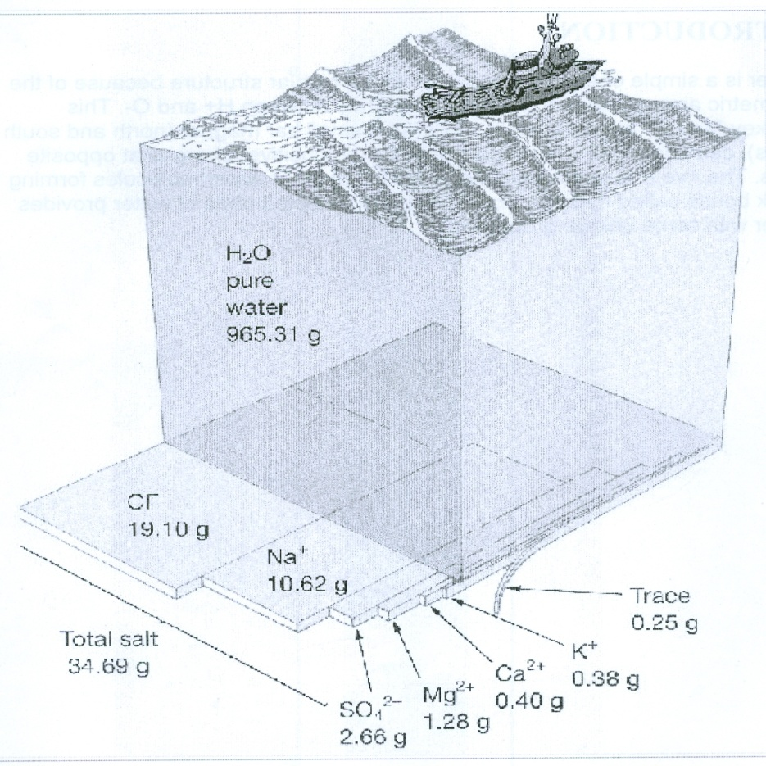
Seawater is a complex mixture of 96.5% water, 2.5% salts, and small amounts of other substances. chemical formula for water is H2O and for salt NaCl.Chemical formula for water is H2o . Its atomic weight is 18.Chemical formula of salt depends on the compounds or elements under going reaction when producing a saltcommon salts are Sodium chloride...

Slide 3
Water molecule

Slide 4
Constancy of composition
The ration of any two major salt constituents in ocean water is constant and is independent of salinity
To quantity salinity – measure of single major ion dissolved in sample of seawater is enough
Cl is measured to determine salinity
The principle of constant composition was evolved during glomar challenger eypedition
The ration of Na+/K+ or cl /So₄² is a fixed value weather the salinity is 25,30,50% or whatever.

Slide 5
Elements present in sea water
Ion | Concentration |  | Percent Free Ion
 | g/kg | mMª
Cl⁻ | 19.354 | 558 | 100
Na⁺ | 10.77 | 479 | 98
Mg⁺⁺ | 1.290 | 54.3 | 89
SO₄⁻⁻ | 2.712 | 28.9 | 39
Ca⁺⁺ | 0.412 | 10.5 | 88
K⁺ | 0.399 | 10.4 | 98
HCO₃^{-b} | 0.12 | 2.0 | 80

Slide 6
Ag | silver | AgCl⁻₂ | 25 pmol/kg⁺₊
Al | Aluminium | Al(OH)⁻₄ | 20nmol/kg
Ar | argon | Ar (gas)
As | Arsenic | AsO₄H²⁻ | 23nmol/kg
Au | Gold | AuCl⁻₄ | ?
B | Boron | B(OH)₃ | 0.42mmol/kg
Ba | Barium | Ba²⁺ | 100nmol/kg
Be | beryllium | BeOH⁺, Be(OH) ° ₂ | 20 pmol/kg
Bi | Bismuth | BiO⁺ ,Bi (OH)⁺₂ | 0.01-0.2 pmol/kg
Br | Bromine | Br⁻ | 0.84mmol/kg

Slide 7
C | Carbon | Co₃₊ H⁻, organic C | 2.3mmol/kg
Ca | Calcium | Ca²⁺ | 10.3mmol/kg
Cd | Cadmium | CdCl ° ₂ | 0.7nmol/kg
Ce | Cerium | CeCO⁺₃, Ce³⁺, CeCl²⁺ | 20 pmol/kg
Cl | Chlorine | Cl⁻ | 0.546 mol/kg
Co | Cobalt | Co²⁺,CoCO ° ₃ , CoCl⁺ | 0.02nmol/kg
Cr | Chromium | CrO²⁻₄, NaCrO₄ | 4nmol/kg
Cs | Cesium | Cs⁺ | 2.2nmol/kg
Cu | Copper | CuCo ° ₃ ,CuOH⁺, Cu²⁺ | 4nmol/kg
F | Fluorine | F⁻, MgF⁺ | 68 µ mol/kg
Fe | Iron | Fe(OH) ° ₃ | 1 nmol/kg
Ga | Gallium | Ga(OH)⁻₄ | ?
Ge | Germanium | Ge(OH)₄, H₃Geo⁻₄ | 70 pmol/kg
H | Hydrogen | H₂O
He | helium | He(gas)

Slide 12
Trace elements in seawater
Chemical ingredients that occur in minute guantities in the ocean
Mn,pb,Hg,Au,I and iron (fe)occur in concentration less than 1 ppm
Low concentrations make certain elements difficult to detect
Trace elements are critically important for marine organisms.

Slide 13
Trace elements in seawater
Trace Element | Concentration(ppb)*
Lithium(Li) | 170
Iodine (I) | 60
Molybdenum (Mo) | 10
Zinc (Zn) | 10
Iron (Fe) | 10
Aluminium (Al) | 10
Copper(Cu) | 3
Manganese(Mn) | 2
Cobalt (Co) | 0.1
Lead (Pb) | 0.03
Mercury (Hg) | 0.03
Gold(Au) | 0.004

Slide 14
Gases in seawater include
Nitrogen (N₂)
Oxygen (O₂)
Carbondioxide (Co₂)
Hydrogen (H₂)
And noble gases-Argon (Ar) neon (Ne), helium (He)
Nitrogen and noble gases are unreactive and do not involve in photosynthesis.
Oxygen and CO₂ involve in photosynthesis and respiration and they vary with space

Slide 15
Dissolved gases % in sea water
S.No | Gas | In surface ocean water %
1. | Nitrogen (N₂) | 47.5
2. | Oxygen(O₂) | 36.0
3. | Carbondioxide | 15.1

Slide 16
Dissolved gases in sea water
Gas | In Dry Air (%) | In Surface Ocean Water (%) | Water-Air Ratio
Nitrogen (N₂) | 78.03 | 47.5 | 0:6
Oxygen(O₂) | 20.99 | 36.0 | 1:7
Carbon dioxide(CO₂) | 0.03 | 15.1 | 503:3
Argon (Ar), hydrogen(H₂), neon (Ne) and helium (He) | 0.95 | 1.4 | 1:5

Slide 17
Carbon dioxide and carbonate cycles
Ocean the major reservoir of CO₂
Ocean contains 50% of CO₂ in Atmosphere
CO₂ occurs as dissolved gas
Highly soluble in seawater
Respiration of Plants and Animals produce CO₂
CO₂ in sea water forms H₂CO₃
Formation and destruction of carbonate shells affects the abundance of carbonate in sea water
The exchange of CO₂ with atmosphere will be at the rate proportional to difference in partial pressure of gas in two media.
The rate of which the exchange of CO₂ between atmosphere and sea interface depends on the rate at which carbon is exchanged between surface layer and deep ocean

Slide 19
Alkalinity
AT is measure of ability of a solution to neutralize acids to the equivalence point of corbonate or biearbonate.
Alkalinity is equal to the stoichrometric sum of the bases in solution
In nature carbonate alkalinity makes up most of the total alkalinity
Compounds that controbute to alkalinity include borate, hydroxide, phosphate, silicate, nitrate and dissolved ammonia.

Slide 20
Dissolved Inorganic matter
The inorgonic mater in seawater includes Co_{3,} So₄² , Cl, No_{3,} Ca++,Mg++

Slide 21
Inorganic agencies affecting composition of sea water
Inflow of river water, freezing and melting of sea ice, biological activity, and exchange of substances with Atmosphere are the factors – affecting composition of seawater.
Spray along the shores also leads to removal of salts along shores
choride content in water is varied through this process
Exchange of gases also modify the quantity of substances in seawater

