Slide 1
QUALITIES OF EGGS AND NATURE OF DEVELOPMENT IN CRUSTACEANS

Slide 2
About the eggs of crustaceans
Crustaceans have external fertilization – mostly the eggs are either fertilized and released for hatching or both the gametes are released for fertilization.
In many crustaceans - the fertilized eggs are released into the water column.
Others may hold their eggs with their body until they hatch.
For many Decapods the eggs are attached to the pleopods.
Notostracans , Anostracans ,and many Isopods form a brood pouch for carrying their eggs.

Slide 3
Some crustaceans carry eggs in an external ovisacs and attach the eggs in rocks in rows. E.g. .Brachyura.
Some may carry eggs between thoracic limps. eg.. Leptostracans and Krill.
Some carry eggs in thin-walled sacs. eg.Copepods.
Eggs of shrimps:
Fecundity-2-10 lakh/ female of app 100g BW.
Egg size: 250-300 micro m in diameter and irregular in shape.
Both eggs and spermatozoa will be released in the water for fertilization.

Slide 4
Eggs in Prawns
After mating once the eggs are matured will be released to the brood chamber.
After fertilization the embryonic development takes place.
Incubation period 19-20 days depending upon the temperature.
Then the hatched larvae will come out from the brood chamber.
The colour of the eggs will turn from orange to slate grey as they develop

Slide 5
Eggs in Crabs
In mud crab, the fertilized eggs are attached to the ovigerous setae of abdominal appendages. They are called berried crabs
Fecundity
S.tranquebarica -2-3 million
S.serrata - 0.5 - 2.5 million
Based on the weight of the body
Crab’s reproductive potential will vary according to the female’s physiological status.
Incubation period 10 – 15 days

Slide 6
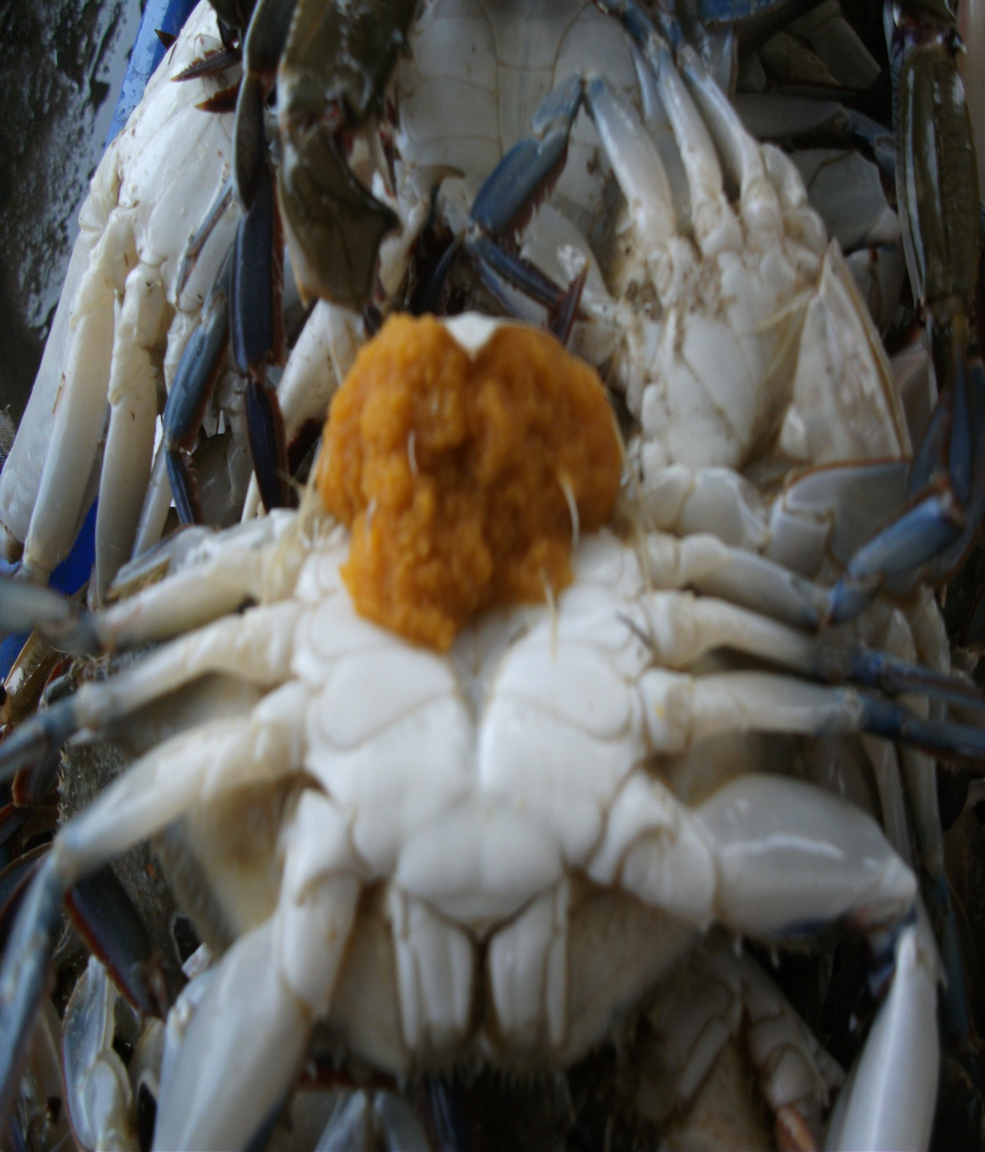
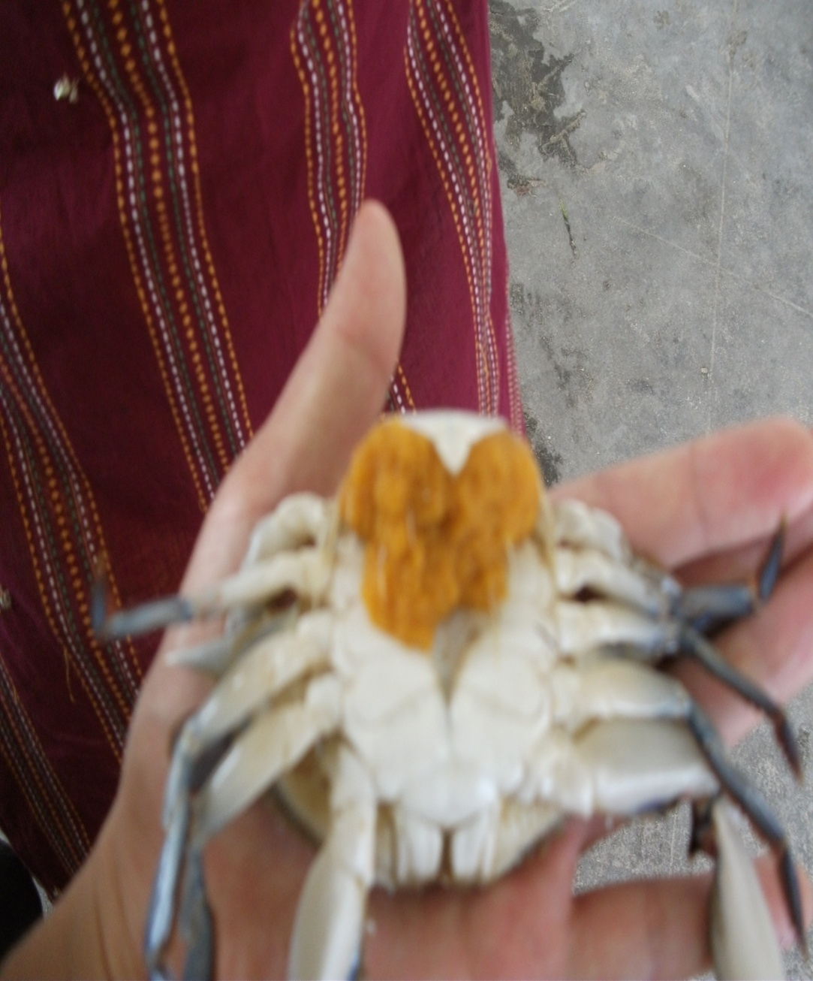
Crab eggs

Slide 7
Cont…
I

Slide 8
Cont…
Eggs will attach female body its self.
So the female body is called a ”Berried”.
Incubation period-2 weeks.
Orange color eggs can be seen in the first period.
During the end of the incubation period, it will be turn into black.

Slide 9
Eggs in Lobsters
Ova will be fertilized in the brood chamber by the deposited spermatozoa.
The fertilized eggs will be attached to the ovigerous setae and with the other eggs by the short stalks from the egg coat
These stalks are produced by the secretion from the follicle cells.
After fertilization the eggs will swell and become soft and sticky when it touched the seawater.
They will hold their eggs for 9-16 months.
During this period they will be loosing 30-50% of the eggs from the clutch.

