Slide 1
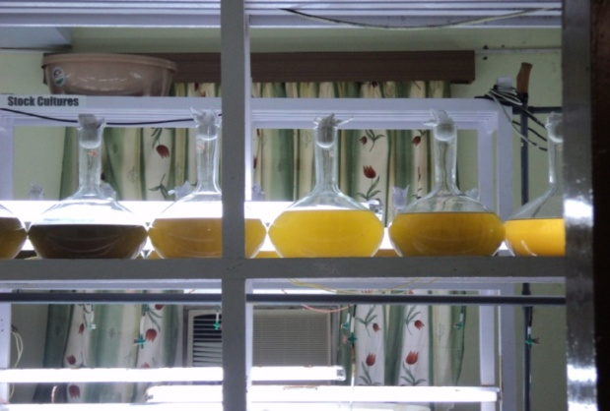
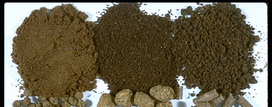
LARVAL FEEDS FOR CRUSTACEANS SEEDS

Slide 2
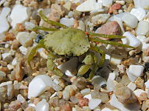
FEEDS FOR BABY CRABS
5 ZOEA
MEGALOPA
CRAB INSTAR

Slide 3
CRAB LARVAL FEEDS
ROTIFERS, ARTEMIA, ALGAL CULTURES
+ ARTIFICIAL SUPPLEMENTARY FEEDS
Zoea 1-Rotifers only
Zoea 2-5- Frozen Artemia Nauplii (FAN) and rotifers
Megalopa and Crab instar -live Artemia
Feed twice a day-morning and afternoon.
Morning-rotifers till Z4
Afternoon-artemia except Z1
Algal culture- Chlorella, Chaetoceros,
Tetraselmis, Skeletonema, Isochrisis.
Crab instar

Slide 4
supplementary feeds
Shrimp larval feed(Japan)-protein49%, fat 31%, Ash 5.5% and moisture 4.3%
Giant freshwater prawn feeds-P55%, F8%, Ash 7% and moisture 5.5%
(Treflan 0.7-10ppm use to control fungal growth in the medium)

Slide 5
CRAB LARVAL FEEDS
LARVAL STAGES | FEEDS | QTY
ZOEA 1-3 | Algal cultures Rotifers Artificial feeds | 30-60no./ml 0.5g/ton water
ZOEA 4-5 | Algal cultures Rotifers+F.artemia Artificial feeds | 5-50nos./ml 0.5g/ton water
MEGALOPA | 2days old live artemia artificial feeds Bit of prawn flesh, bivalves, molluscs, squids & fish | 50nos./ml 150-200g/ton of water
CRAB INSTAR | Flesh of prawn, bivalves, molluscs & fish Artificial feeds | 3-5% of biomass 0.5g/ton water

Slide 6
CARE
RISK- High mortality- survival rate as low as just 5-15%
Excess foods/ faecal matters/ dead larvae/ moulted shell required to be continuously siphon out
Continuous water aeration

Slide 7
FEEDS FOR LOBSTER LARVAE- PHYLLOSOMA

Slide 8
LOBSTERS LARVAL FEEDS
The flat phyllosoma feeds on plankton before the metamorphosis into the juvenile state.
Only Artemia and gonals of blue mussels mytilus in nursery tank
Adults are nocturnal and migratory, living among rocks at depths of up to 65 m (213 ft), and feeding on sea urchins, clams, mussels and worms.

