Slide 1
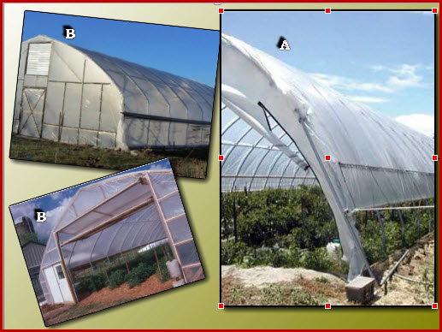
Quonset (A) and Gothic (B) shaped high tunnels

Slide 2
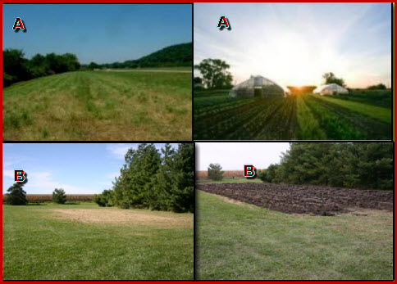
Site for Greenhouse Construction
(A: Site with good sunlight, B: site with wind breaks)

Slide 3
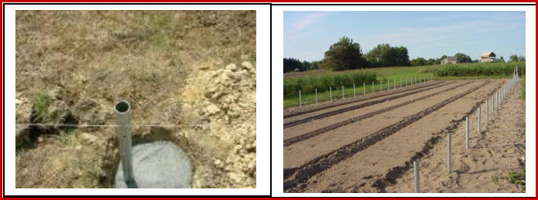
Marking of field and installation of ground post

Slide 4
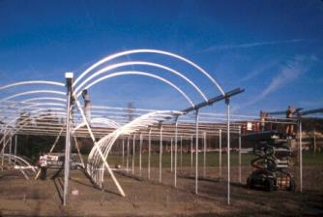
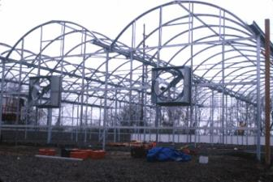
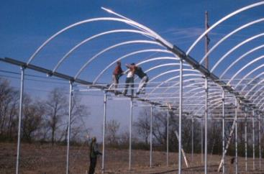
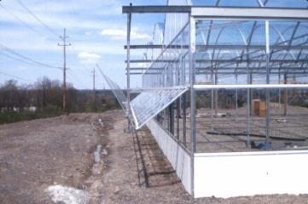
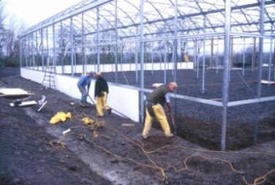
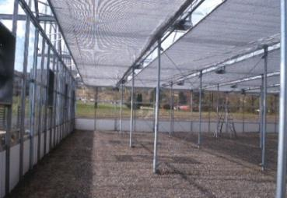
Construction of Pipe Frame Structure

Slide 5
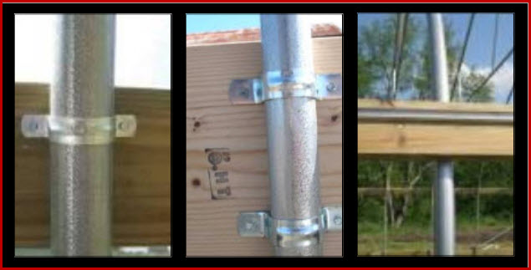
Purlins, cross braces, base boards and hip boards are attached to each bow to provide stability to the high tunnel frame.
Pipe straps are used to secure the baseboards and hip boards to the high tunnel frame. Aluminum channel lock is used to secure the plastic to the frame.

Slide 6
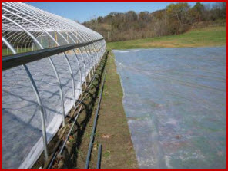
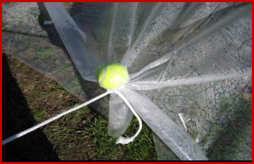
Covering of plastic over high tunnel frame

Slide 7
Sidewalls are rolled-up to facilitate cross-ventilation within the high tunnel.

Slide 8
Plastic is secured to the frame with wiggle wire within each channel lock. Rope can be laced along the sidewall for tightening the roll-up sides.
L-shaped handle for rolling the sidewalls up or down.

Slide 9
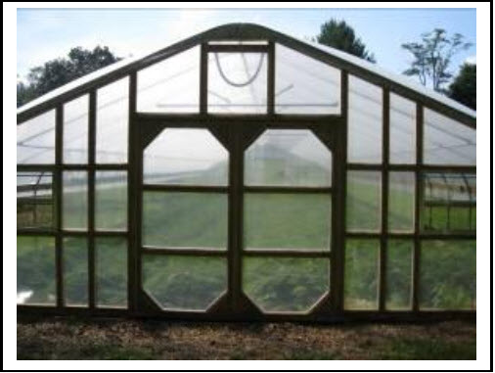
Different end wall designs for high tunnel structures

Slide 10
Batten tape is used to secure the plastic to the end wall frame.

Slide 11
PVC-framed high tunnels are functional high tunnels

