Slide 1
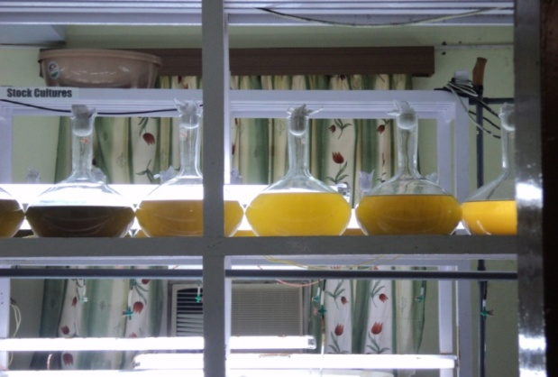
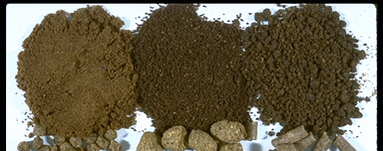
LARVAL FEEDS FOR CRUSTACEANS SEEDS

Slide 2
FEEDS FOR SHRIMP LARVAE
NAUPLII STAGE(1-6)-36hrs – Depends on the stored nutrients from the eggs. - Begin feeding at N6
Isochrysis(stage 1)
Brown algae(3-5 μm)
Chaetoceros(stage1-3)
Diatom(4-6 μm)
Tetraselmis
Green algae(10-15 μm)
Platymonas
ZOEA STAGE:
Three zoeal substages
feeds on phytoplankton

Slide 3
LARVAL STAGES | FEEDS | QNTY | FEEDING TIME
NAUPLIUS | - | - | -
PROTOZOEA Stage 1-2 Stage 3 | 1-Isochrysis+Chaetoceros 3 days old chaetoceros and 4 days old Platymonas+ isochrysis | 80,000-1,00,000cells/ml | Twice- once in morning and at 4pm
MYSIS stage 1 Stage 3 POST LARVAE | freshly hatched artemia nauplii unicellular algae Algal feeding Artemia nauplius | 1 nauplius/4ml 1N/2ml 1lakh cells/ml 60,000cells/ml 1/ml | 3 times/day
Unicellular algae such as Chaetoceros and Platymonas
Algal feeding-3 times/day-once in morning, 12pm noon, 4pm evening.

Slide 4
Larval Feeding Mysis
Feed on large algae cells at early stage.
Switch to Artemia (brine shrimp) for later stages

Slide 5
Larval Feeding Postlarvae
Artemia
Formulated diet
35% protein
3% fat
Feeding rate
200% body wt/day
50%x 4 times per day.
GALVESTON SYSTEM
200 lits of mixed phytoplanktons predominantly Chaetoceros(2lakh cells/ml)-feeds for the protozoae.
Mysis, frozen brachionus @100rotifer/larva/day.
Crushed and washed clam meat can also be given

Slide 6
The effect of Artemia replacement. The use of microbound feeds decreases survival or growth when fed at levels of 40-50% or higher. In controlled laboratory conditions, however, the results are generally better than in commercial hatcheries.
Species | Diet | Artemia replacement (%) | Larval stages | Result compared to Artemia control
P.Monodon | Crumbled experimental microbound diet | 100 | Z-PL | Similar survival but lower growth
l.vannamei | Microencapsulated diet | 70-1oo | Z-PL | 80% survival compared to 90% survival in live
L setiferus | Crumbled experimental microbound diets | 40, 60, 100 |  | Decreased survival, growth, development and stress resistance (but similar survival at 40 and 60% in the presence of algae)

Slide 7
11 LARVAL STAGES+POST LARVAE
PRAWN’S LARVAL FEEDS

Slide 8
PRAWN LARVAL FEEDS
Artemia nauplii, cut piece of mushroom and earthworm, fish flesh, hens egg(custard), soya products, freshwater snails, marine bivalves, squilla, tubifex worm, lamellidens and prepared feeds.
Feeding starts on the second day of hatching

Slide 9
PRAWN LARVAL FEEDS Developed at CIFA
FEED TYPES | INGREDIENTS | Qty % by wt
TYPE-I | Freshwater mussels meat(foot & gonad) Hens eggs Skimmed milk powder Vitamin mineral mix | 68 20 10 2
TYPE-II | Fish flesh Hens eggs Wheat flour Skimmed milk powder Vitamin mineral mix | 68 20 5 5 2
All ingredients of the prepared feeds should be thoroughly ground and mixed in a grinder with little water

Slide 10
CARE
Prepared feeds usually given day time
Different stages required 50-150 ug prepared feed/larva/day
Artemia nauplii-5-50/larval/day-usually given at night to ensure food availability throughout the night.
Inadequate feeding will leads to stunted growth, cannibalism etc.
Regular tank cleaning require.

