Slide 1
Principles of chromatography

Slide 2
Chromatography
‘Chromatography’ term - Mikhail Tswett (1906)
Chroma = color, graphein = written
Each substance → Different molecules
Molecules separate as they move through some type of porous matrix
Separation takes place due to
Adsorption of molecules
Differential migration (partition) of molecules

Slide 3
Phases of chromatography
Two phases
Mobile phase - a moving solvent
Stationary phase - an immobile matrix
Immobile matrix contain sites to which molecules from the mobile phase can bind
If the molecules interact (bind) with the material of matrix - their movement through matrix is retarded. This is called Impedance

Slide 4
Separation interaction
Greater the affinity of a particular molecule for the matrix, slower is their movement down through the column
Different components have different affinity for the matrix – so retarded to different degrees
Chromatography thus works on
propelling of molecules through the column and
their selective impedance by matrix

Slide 5
Distribution coefficient
This is the basic principle of chromatography
This coefficient describes the way in which a compound distributes itself between two immiscible phases
This coefficient is constant for a compound
Distribution or Partition Coefficient
Defined as concentration of a compound in the mobile phase by the concentration of a compound in stationery phase.
Conc. in solvent A
DC = ------------------------ = Constant
Conc. in solvent B

Slide 7
Distribution coefficient…
If the distribution coefficient is 1.
After five equilibrations, the compound is distributed throughout the whole column but is maximally concentrated at the center of the column.
If the distribution coefficient is <1
More than 50% of the compound would be left on solid phase after each equilibration and the concentration peak is above the center of the column and vice versa.
Greater the number of equilibrations, the greater becomes the concentration of compound on a certain part of the column

Slide 8
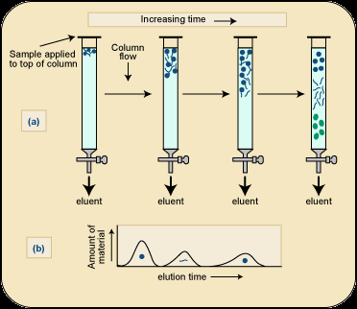

Slide 9
Factors influencing separation
Two factors influencing resolution
Effective distribution coefficient
Sharpness of compound band on the column
Sharpness depends on the number of equilibrations
Number of equilibrations is termed as “Theoretical plates”
Greater the number of theoretical plates, the column is more efficient.

Slide 10
Components
Chromatographic system consists of two phases
Stationery phase:
Solid, gel, liquid or immobilized solid/ liquid mixture
Mobile phase:
Liquid or gas
Its flows over/ through the stationery phase.

Slide 11
Applications
Separation of pigments, proteins, amino acids, DNA, RNA, and their nucleotides.
Separation of components of colorless compounds or colorless substances from a mixture
Used for fractioning gases, liquids or dissolved solids

Slide 12
Types of chromatography
Adsorption chromatography
Affinity chromatography
Ion exchange chromatography
Thin layer chromatography
Partition chromatography
Paper chromatography
High pressure liquid chromatography
Gas chromatography

Slide 13
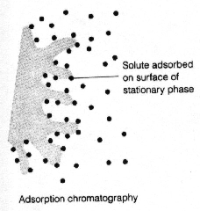
Adsorption chromatography
Stationery – solid adsorbent bed
Mobile - liquid or gaseous
Mobile phase adsorbed onto the surface of a stationary solid phase
Equilibration between phases accounts for the separation
Different compounds adsorbed on the bed at different rates

Slide 14
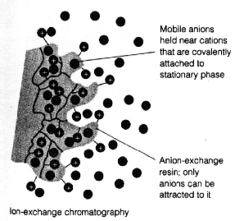
Ion exchange chromatography
Stationery – Resin that covalently attach anions or cations
Mobile – Liquid
Separation - Solute ions of the opposite charge in the mobile liquid phase attracted to the resin by electrostatic forces
Two different modes, i.e. planar and column

Slide 15
Types of ion exchangers
Two types of exchangers
Cation exchanger:
Stationary phase carries a negative charge
Anion exchanger:
Stationary phase carries a positive charge.
Charged molecules in the liquid phase pass through the column until a binding site in the stationary phase appears
Molecule will not elute from the column until a solution of varying pH or ionic strength is passed through it
Thus, separation is highly selective

Slide 16
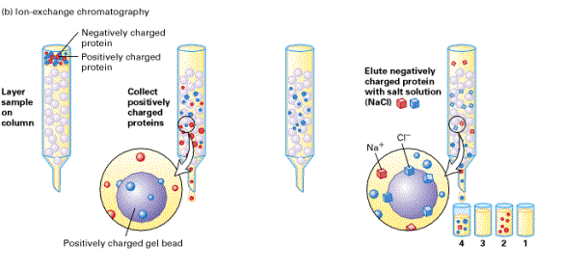

Slide 17
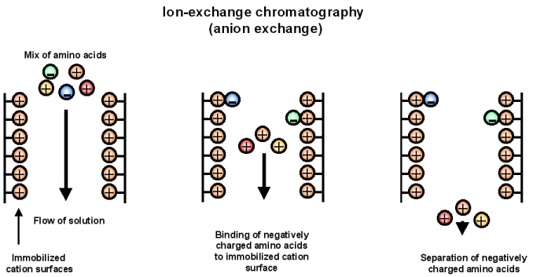
Applications
Purification of biological materials
Separation of charged compounds like the peptides, amino acids, proteins, etc.

Slide 18
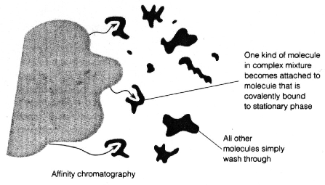
Affinity chromatography
Stationery : Immobilized molecule, an antibody to some specific protein on a solid matrix.
Mobile : Liquid
Separation : Specific non covalent interaction between solute molecule and a molecule that is immobilized on a stationary phase
Mixture of proteins - only the specific protein is reacted to this antibody - later extracted by changing the ionic strength or pH.
Purification of protein

Slide 21
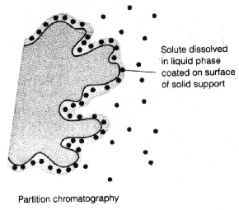
Partition chromatography
A mixture is separated by the partition of a solute between two solvents
One of the solvents is immobilized with the help of a substance present in the filter paper or column
A thin film formed on the surface of a solid support by a liquid stationary phase.

Slide 22
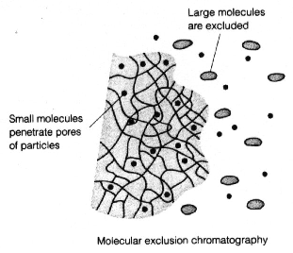
Size exclusion chromatography Gel permeation chromatography Gel filtration
Stationery – Porous gel
Mobile – Liquid
Separation – Mixture pass through porous gel are separated on the basis of their size (hydrodynamic diameter)
Small pores exclude the larger molecules but allows smaller molecules to enter the gel
Larger molecules are washed out quickly
Smaller molecules take more time to elute.
Protein separation and purification

Slide 23
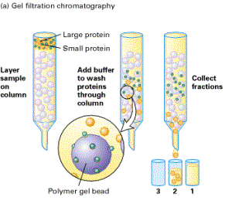

Slide 24
High performance liquid chromatography (HPLC)
Separation : Basis of their idiosyncratic polarities. Interaction of analyte with the stationary phase of the column
Equipments for HPLC include
Pump - Used for moving the mobile phase and analyte through the column
Stationary phase
Detector - retention time for the analyte is provided by the detector.
Retention time of compounds vary with strength of interactions that take place between analyte and the stationary phase

Slide 25
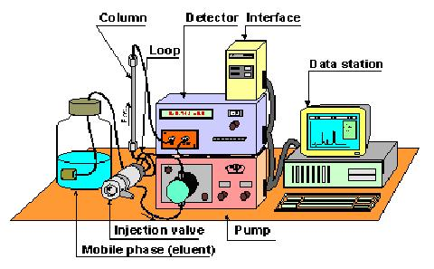
HPLC system

Slide 26
Different chromatographic techniques, their property, mobile and stationery phases
Techniques | Solute property | Stationery phase | Mobile phase
Adsorption chromatography | Size and shape | Hydrated gel | Usually aqueous
Ion exchange chromatography | Ionization | Matrix with ionized groups | Aqueous buffer
Gel filtration | Adsorption | Adsorbent, usually inorganic material | Non polar
Paper chromatography | Adsorption | Whatman paper No-1 | Aqueous
Affinity chromatography | Covalent linkage | Porous agarose gel | Aqueous
Partition chromatography | Solubility | Inert support | Mixture of polar and non polar solvents
Thin-layer chromatography | Adsorption | Matrix of cellulose, alumina or ion exchange resin | Aqueous
Gas chromatography | Adsorption | Liquid or solid | Gas

