Slide 1
PATTREN OF PRIMARY PRODUCTION

Slide 2
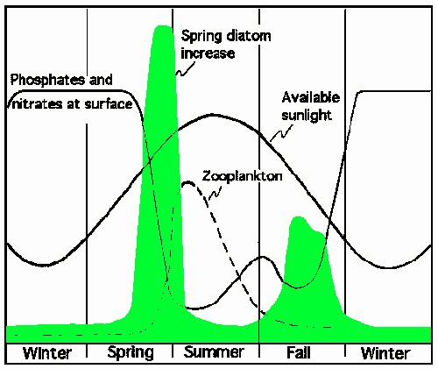
Seasonal and regional variations are common phenomenon in nature. In temperate latitudes, seasonal variations are distinct and regular compared to constant, irregular production in tropical environments
Seasonal trends in primary production

Slide 3
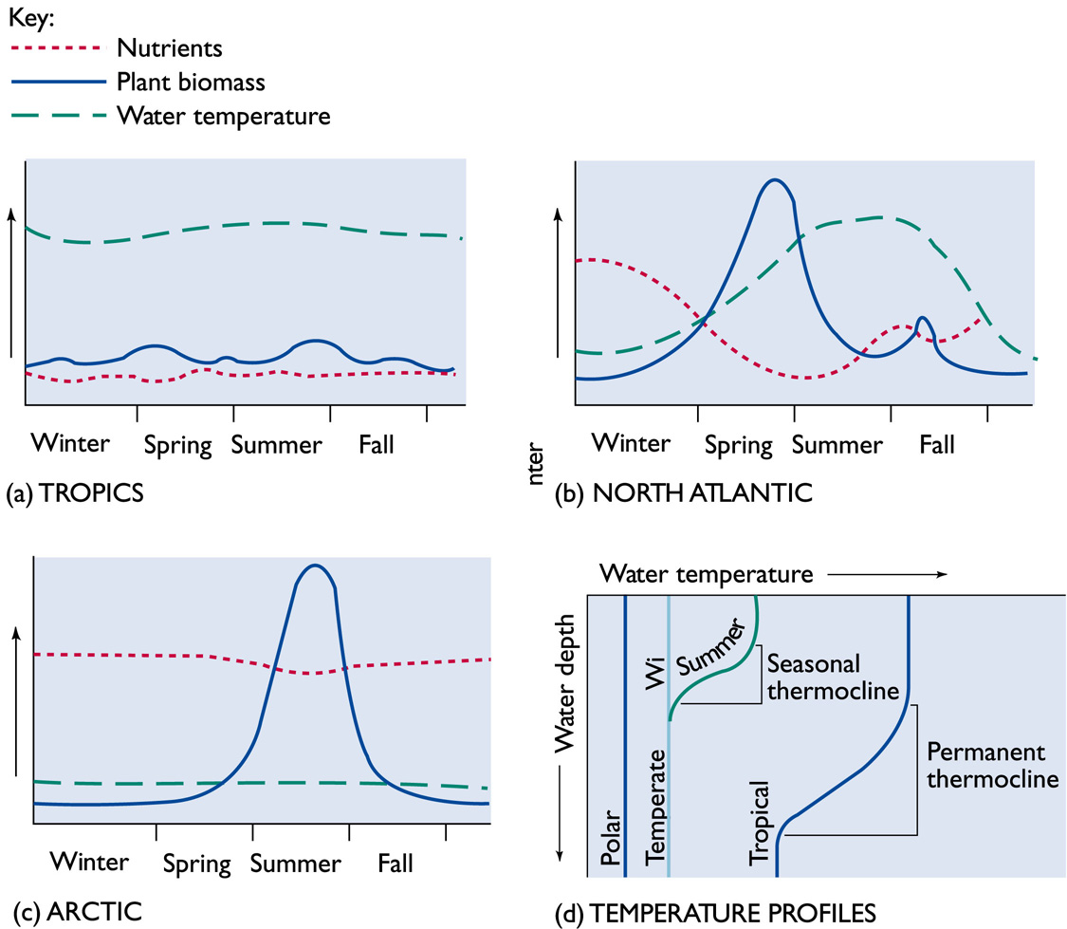
Types of production
Regular production
Irregular production

Slide 4
The variation can be attributed to temperature, illumination and availability of nutrients in the euphotic zone
Winter period - high concentration of nutrients - but decrease in illumination and temperature - prevent the increase of phytoplankton production during summer season as a result of the formation of the thermo cline
The nutrient replenishment of the euphotic zone results in low phytoplankton
During autumn even though nutrients concentration was more due to decrease of both illumination and temperature caused for lower phytoplankton production
High production during spring season was attributed to the high illumination and temperature

Slide 5
FACTORS INFLUENCE PRIMARY PRODUCTION
Light
Temperature
Salinity
Nutrients
Minion nutrients
Organic substance
Grazing of zooplankton

Slide 6
Light
Photosynthesis is directly proportional to the light intensity of solar radiation
About 80% incident visible light reaches 120m. depth in a clear offshore waters and 10-20 m. in turbid inshore waters
0.02 to 2% of light will be used by most plants
Day hours - max photosynthesis - between 5-20 meters
High phytoplankton biomass - in the euphonic zone by shade plankton

Slide 7
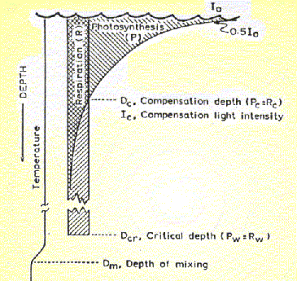
Relationship between composition light depth, critical depth and the depth mixing
Plant growth or net predation occurs when photosynthesis exceeds respiration the depth at which photosynthesis and respiration equal is called compensation depth (CD)
Below the CD - no production
Area above the CD - euphotic zone - 80 m
From the Figure an area of ABCD indicates the amount of plant material used up in respiration is matched against the amount gained by photosynthesis (Area- ACE)

Slide 8
Note: If phytoplankton cells are mixed down below D_{critical,} there can be no net photosynthesis
However as long as the depth of mixing is above the critical depth there can be net photosynthesis.
E.g., Euphotic depth –Gulf manner and Palk bay- 6m; West coast of India varied to be 50-60m and 90m. in the clear waters of Laccadive sea
The rate of photosynthesis varies in proportion to light intensity and there is a limit a light saturation by plant

Slide 9
Compensation depth
It is the depth at which the amount of respiration exactly balances the amount of photosynthesis is referred to as compensation depth
Critical depth
The depth at which a population of phytoplankton cells can be mixed until photosynthetic gain is balanced by respiratory losses ( P_{W} = R_{W})

Slide 10
Nutrient
Productivity - amount of carbon fixed per unit time
Productivity - assimilation index in which growth is expressed as mg of carbon produced per mg chlorophyll ‘a’ per hour
Phosphate and Nitrates are the two major nutrients recognized as one of the major factors limiting primary productivity
Phytoplankton absorbs nutrients from the solution during photosynthesis for the formation of particulate organic matter

Slide 11
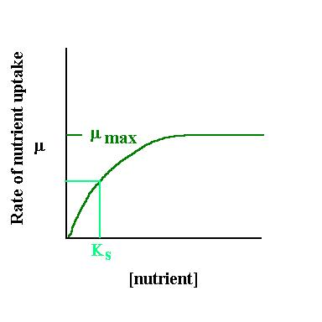
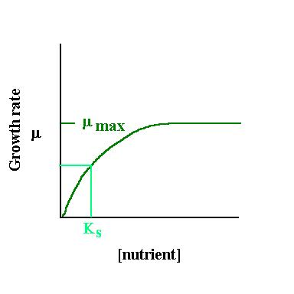
Growth rates – Nutrient uptake velocity
1. Growth and nutrient uptake curves generally follow the same pattern
2. Generally follows Michaelis-Menton uptake curve
Where µ= growth rate (or nutrient uptake rate) S = substrate concentration
K_{s} = substrate concentration where growth rate is half of maximum

Slide 12
Factors affecting uptake of nutrients
1. Cell size – amount of surface area relative to volume; surface area/volume gets
lower as cell gets bigger
2.Nutritional state of cell
a. Luxury uptake – cells take up more than they need
b. Inhibition by internal stores
3. Transport limitation
a. sinking speed or swimming speed
b. turbulence
4. Inducible enzyme systems affect Ks
5. Toxicity effects (if nutrient abundance too high)

Slide 13
MINOR NUTRIENTS
Minor nutrients - Fe, Mn, Cu, Zn, vanadium, cobalt and molybdenum are known to limit primary production
Lower concentration of Iron is known to limit plant growth particularly in Neritic waters
Neritic species -Skeletonema costatum requires high concentrations iron along with PO₄ and NO₃ by diatoms and silicoflagellates for shell formation
Note: Calcium, magnesium, potassium, sodium ions are required by plants in trace quantities
These elements will help to keep ionic regulation of cells and the formation of hard parts, enzymatic activity etc.

Slide 14
ORGANIC SUBSTANCES
Organic substances - influence the plant growth
Organic substance - produced by decomposition and excretion of organisms
Diatoms, coccolithophorids and dinoflagellats, bacteria, fungi etc, present below the euphoric zone can utilize dissolved organic matter in the water
Some algae can utilize organic carbon such as glucose and lactate
Some diatoms, flagellates can utilize nitrogen as aminoacid, urea, uric acid etc.
Certain vitamins such as vit B_{12,} B thiamine and biotin.

