Slide 1
COASTAL ECOSYSTEMS

Slide 2
COASTAL ZONE AND CLASSIFICATION
A coastal zone - interface between the land and water
Continually changing because of the dynamic interaction between the oceans and the land
The energy reaching the coast can become high during storms, and such high energies make coastal zones areas of high vulnerability to natural physical processes
Tidal rise and fall are regular and predictable coastal phenomenon
Unpredictable environmental factors influencing the habitat and specialized fauna - flora and adapted to regulate the production in this active zone of the marine costal ecosystem

Slide 3
Coastal ecosystems
Sea itself (continental , inshore, shallow water zone)
Estuaries
Mangroves
Coral reefs
Sea grass bed
Intertidal zone (Littoral zone)

Slide 4
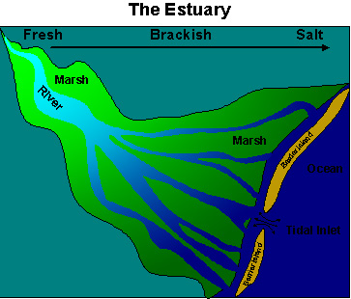
ESTUARIES
Estuaries are partially enclosed bodies of water along coastlines where fresh water and salt water meet and mix
D.W. Pritchard (1967): "An estuary is a semi-enclosed coastal body of water which has a free connection with the open sea and within which sea water is measurably diluted with fresh water derived from land drainage."

Slide 5
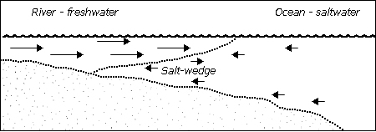
Estuary act as a transition zone between oceans and continents
An estuary has a free connection with the ocean
Fresh water input from land sources (usually rivers) dilutes the estuary's salt content

Slide 6
Estuaries - high secondary productivity
The detritus forms a substrate for a rich bacterial and algal growth - an important food source for various suspension and detritus-feeding animals
This accumulation of detritus forms an important source of food for many estuarine organisms.

Slide 7
Estuaries - called the "nurseries of the sea" because the protected environment and abundant food provide an ideal location for fish and shellfish to reproduce
Besides fish, many species of birds depend on estuaries for food and nesting areas
Marine mammals also use estuaries as feeding grounds and nurseries
Estuaries filter sediment and pollutants from the water before it flows into the oceans
Excess nutrients are removed in bordering salt marshes, resulting in cleaner water for people and marine organisms

Slide 8
CLASSIFICATIONS OF ESTUARIES
1. Estuaries based on geomorphology:
Coastal Plain Estuaries are formed by sea level rising and filling an existing river valley. Chesapeake Bay in Maryland and the harbour of Charleston, South Carolina.
Tectonic Estuaries are caused by the folding or faulting of land surfaces. Eg. the San Francisco Bay area in California.
Bar-built Estuaries form when a shallow lagoon or bay is protected from the ocean by a sand bar or barrier island. Examples the Eastern Seaboard and the Gulf Coast of North America.
Fjords are U-shaped valleys formed by glacial action. Fjords are found in Northern Europe, Alaska and Canada.

Slide 9
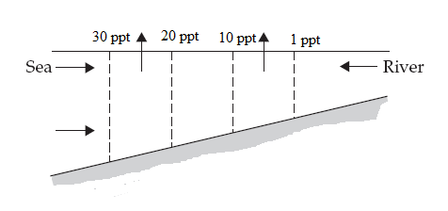
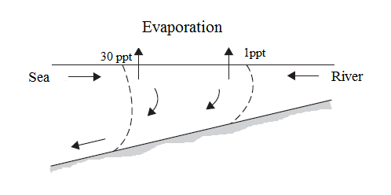
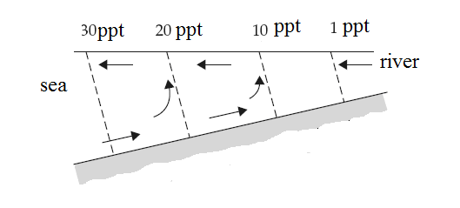
2. Estuaries based on circulation
Salt-wedge estuary or Positive estuaries-A salt-wedge estuary is highly stratified
Salt water moves into it in the shape of a wedge, with fresh water flowing over it. The Mississippi River estuary is an example of this type
Well mixed estuaries or Neutral estuaries- The vertically homogenous or well-mixed estuary is characterized by low inflow of fresh water and large tidal ranges.
Evaporate estuaries or Negative estuaries- In desert climates where the amount of freshwater input to the estuary is small and the rate of evaporation high, a negative or evaporate estuary results.
Positive estuary Neutral estuary Negative estuary

Slide 10
CHARACTERISTICS OF ESTUARY
Salinity:
Variations in salinity are affected by temperature, dissolved gases, density and viscosity
Salinity in the estuary varies with depth, flux of fresh water, and changes with the tide
Floods result in reduced salinity and drought can result in higher salinity

Slide 11
Temperature:
Shallow estuarine waters exhibit great temperature changes.
The sun heats up the estuary during the day and cools at night due to influx of water from rivers and the sea
Tides also affect estuarine temperatures at high tide, the deeper, lower reaches of the estuary remain cool, and only the top layers are heated by the sun

Slide 12
Oxygen:
In highly stratified estuaries, the level of biological activity in the lower levels can deplete oxygen levels
When mixing is low and tidal effects are minimal, replenishment of oxygen in the estuary may be minimal
Sediment:
Infiltration of the estuarine sediments by nutrients, trace elements, sewage and industrial waste can influence the productivity of the estuary

Slide 13
Wave action:
This effect is very minimal in estuaries and hence more amounts of sediments are settled along the bottom of the estuaries
This reduced wave action in turn promotes the deposition of sediments and development of rooted plants in the estuarine regions
Turbidity:
As this region is having good amounts of fine sediments or particles, turbidity of the estuarine waters is very high in most of the periods
The highest turbidities are known to occur during the maximum freshwater discharge into the estuaries

Slide 14
CLASSIFICATION OF ORGANISMS
The estuarine organisms are classified based on the salinity tolerance levels as follows:
1. Oligohaline organisms
Most of the freshwater forms inhabiting rivers which cannot tolerate variations in salinity of more than 0.1 ppt and which are not found at the head of the estuary
Some oligohaline species at the head may tolerate salinities up to 5 ppt and a few even as high as 19 ppt

Slide 15
2. True estuarine organisms
Are euryhaline forms and are restricted to estuaries only
These are adapted to the wide variations of salinity
Are known to live both in the upper and middle reaches of the estuaries with low saline conditions

Slide 16
3. Euryhaline marine organisms
Extend their distribution from the sea to the upper reaches of the estuary
Can tolerate salinity as low as 15 ppt and a few even 5ppt
Form the majority of the total estuarine biota
4. Stenohaline marine organisms
These organisms live on the open sea shore and at mouths of the estuaries
They do not enter the estuaries below salinities of 25 ppt

Slide 17
BIOTA OF ESTUARIES
Estuaries - homes to unique aquatic plants and animals, such as sea grass, sea turtles and sea lions
Two major challenges - variable of salinity and regular tidal influence
Most solutions are behavioral adaptations such as burrowing or simply closing shells when there isn't enough water
The bivalve closes its valves when the level of salinity becomes too low
Some marine worms and amphipods bury themselves in sediments

Slide 18
I. Flora
Diatoms - Skeletonema, Coscinodiscus, Biddulphia. Synedra. Navicula
Asterionella, Hemidiscus, Chaetoceros, Pleurosigma, etc
Algae - Sprogyra, Eudorina, Pandorina, Lyngbya, Microcystis,
Oscillatoria, Spirulina, etc
Chara Seagrasses- Cymodocea serrulata, Enhalus acoroides, Halophila ovalis etc.
Salt marsh vgetation- Salicornia, Sueda, Spartina etc
Mangroves - Avicennia, Rhizophora, Ceriops, etc

Slide 19
II. Fauna
Protozoa- Euglena, Vovox, Ceratium, Peridinium, Noctiluca, Vorticella, etc
Coelenterata- Sea anemones, hydrozoan medusae
Rotifera- Brachionus spp
Annelida- Tubifex sp, Arenicola sp, Nereis sp, etc
Arthropoda- Cyclops, Calanus, Acartia, Oithona, Penlia, Moina, Uca,
Neptunus, Scylla, Hermit crabs, Palaeomon, Metaphenaeus, shrimps, isopods, barnacles, Gammarus, Sphaeroma, etc
Finfishes – Mullets ( Mugil sp.), Therapon sp. Lates calcarifer,
eels, mud skipper etc.
Aquatic Mammals – Dolphins, sea cow and manatee
Terrestrial mammals – Rodents, rabbits, tigers, etc.
Reptiles – Crocodile, sea snake, tree snakes etc
Birds - Cormorants, pelicans, etc

Slide 20
ESTUARINE HABITATS OF INDIA
Hooghly-Matlah estuary in West Bengal
Mahandi estuary in Orissa
Godavari estuary in Andhra Pradesh
Adayar Estuary
Vellar estuary
Cauvery estuary
Apart from these, there are brackishwater lakes such as Chilka Lake in Orissa, Pulicat Lake in Tamilnadu and the Vembanad and Kadinamkulam backwaters in Kerala are important.

Slide 21
MANGROVES ECOSYSTEM
The term mangrove refers to an ecological group of halophytic plant species found along sheltered tropical and subtropical shores
It is a diverse group of plants that are adapted to wet, saline intertidal habitats
Terms such as mangrove community, mangrove ecosystem, mangrove forest, mangrove swamp, and mangal are used to describe the entire mangrove community
Healthy mangrove forests are key to a healthy marine ecology
The mangroves make an enormous contribution to the food chain that supports the coastal fisheries

Slide 22
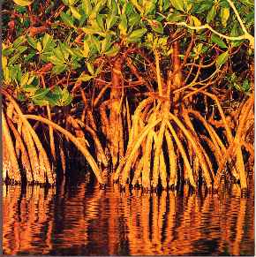
Mangroves extend over 18 million hectares worldwide, covering a quarter of the world's tropical coastline
Largest mangrove areas occur in Indonesia (30%) followed by Nigeria (10%), Australia (8%) and Mexico (7%)
India contributes approximately 3% to the world mangrove area
Sunderbans in West Bengal accounts for a little less than half of the total area under mangroves in India.

Slide 23
MANGROVE WETLANDS OF INDIA
State | Mangrove wetland | Total area of the wetland (ha)* | Actual forest cover (ha)
East coast
 | Sunderbans | 4,26,000 | 2,12,500
Orissa | Mahanadi | 67,000 | 21,500
Andhra Pradesh | Godavari | 33,250 | 24,100
 | Krishna | 25,000 | 15,600
Tamil Nadu | Pichavaram | 1,300 | 900
 | Muthupet | 13,000 | 1,200
West coast
Gujarat | Gulf of Kutch | 58,200 | 85,400
 | Gulf of Khambat | 53,123 | 17,700
 | Other mangroves | – – | 1 1,600
Andaman and Nicobar islands | Andaman islands | -- | 92,900
 | Nicobar islands | -- | 3,700
Total |  |  | 4,87,100

Slide 24
Mangrove habitat
Mangrove distribution is determined primarily by sea level and its fluctuations and secondarily by air temperature, salinity, ocean currents, storms, shore slope, and soil substrate
Most mangroves mostly live on muddy soils, but they can also grow on sand, peat and coral rocks
Some mangrove species occur close to the shores, fringing islands, and sheltered bays; further inland in the estuaries influenced by tidal action.

Slide 25
Mangroves vary in height according to species and environment from shrubs to tall trees
The roots of some mangrove species such as Rhizophora spp. (red mangrove) contain the pneumataphores- the unique breathing roots and Avicennia spp. (black mangrove) contain many small "breathing" pores, called "lenticels."
These allow oxygen to diffuse into the plant and down to the underground roots by means of air space tissue in the cortex, called "parenchyma."
The lenticels are inactive during high tide
Certain species of mangroves exclude salt from their systems while, others actually excrete the salt via their leaves, roots, or branches

Slide 26
FACTORS INFLUENCE MANGROVE ENVIRONMENT
Salinity
Mangroves are capable of living in the salt water by reverse osmosis at the root level
Some species can exclude more than 90% of salt from the body
Also, secrete salt through the use of special glands on the leaves of the tree, which are among the most active salt-secreting systems known
Leaves with thick, waxy cuticles and stomata found only on their lower surfaces are examples of such modification

Slide 27
Survival in the anoxic soil
The red mangroves, Rhizophora, the root system is kept above the loose, anoxic soils so as to have contact with air for respiration as against keeping the roots below the soil in other plants
In black mangroves, Avicennia spp. the presence of respiratory roots or pneumatophores extending above the anoxic mud surface of the mangrove habitats so to have gaseous exchange is a special adaptation for efficient respiration mechanisms

Slide 28
Production of a propagule
Many show vivipary (Eg. Rhizophora)
The seed is germinated on the parent tree and grows by combination of photosynthesis and acquisition of nutrients from the parent
This structure, which is neither a seed nor a fruit, which usually termed a propagule, then falls to the ground and propagate and grow
Succulent stem
Some mangrove plants are known to have succulent stem to conserve water in its body

Slide 29
IMPORTANCE OF MANGROVES
Protect coastlines against erosive wave action and strong coastal winds, and serve as natural barriers against tsunamis and torrential storms
Refuge and nursery grounds - mangrove areas are excellent nursery grounds for a variety of commercially important prawns, crabs and fin-fishes, as they provide necessary food and shelter for living organisms
These ecosystems also provides food, roosting, nesting site and shelter to a large varieties of birds
Are important breeding ground for many fishes, crabs, prawns and other marine animals

Slide 30
Fallen leaves and branches from mangroves contribute to the detritus and provide nutrients for the marine environment. These ecosystems are quite productive (350 – 500 g C m^{–2} yr^{–1}).
Prevent salt water from intruding into rivers
Retain, concentrate and recycle nutrients and remove toxicants through a natural filtering process
Provide resources for coastal communities who depend on the plants for timber, fuel, food, medicinal herbs and other natural products

Slide 31
FLORA & FAUNA OF MANGROVES
Plants
Two families, Avicenniaceae and Rhizophoraceae dominate in terms of number of species and abundance
Common genera - Rhizophora (red mangrove), Avicennia (balck mangrove), Aegiceros, Laguncularia, Lumnitzera, Bruguiera, Ceriops, Sonneratia, Xylocarpus, Heritiera etc.
Microalgae
Mangroves are rich in phytoplankton species such as Navicula, Thalassiothrix, Pleurosigma, Ceratium, Peridinium, etc.

Slide 32
Animals
Invertebrates
Zooplankton: Foraminiferans, copepods, rotifers, cladocerans etc.
Annelida: Polychaete (Arenicola sp.)
Marine Prawns: Penaeus spp., Metapenaeus spp., Acetus indicus, etc.
Snapping prawn: Alpheus spp.; Mud shrimp: Upogebia sp.
Mud crabs: Scylla spp. (S. serrata); Ghost crabs: Dotilla sp. etc. ;
Fiddler crabs: Uca spp.; Hermit crabs: Clibanarius sp; Mangrove crab: Aratus sp.
Mud lobster: Thalassina anomala
Barnacles: Balanus sp, Lepas sp. etc.,
Isopoda: Sphaeroma sp ( wood borer).

Slide 33
Insects
Molluscs Gastropods (Nerita, Littorina,Telescopium , Cerithidea,); bivalves
(oysters, clams, cockles)
Fishes: Sea bass, grouper, mudskippers, mangrove archer fish
Amphibians: Tree frogs
Turtles: Marine turtles like Olive Ridley (Lepidochelys olivacea), Green
Sea Turtle (Chelonia mydas), Hawksbill Turtle (Eritmochelys imbricata),
Snakes: Water snakes, mangrove pit-viper, mangrove cat snake
Crocodile: Crocodile (Crocodilus porosus),
Birds - Brahminy kite(Haliasturindicus), kingfishers,
woodpeckers,herons, egrets (Egretta garzetta)
Mammals- Long-tailed monkey (Macaca fascicularis), fruit bats
(Macroglossus minimus, Eonycterisspelaea) , otters, river dolphins (Platanista gangeticus), etc.

Slide 34
CORAL REEF ECOSYSTEM
Coral reefs are living animal colonies, found in marine waters
Often called “rainforests of the sea”
Most diverse ecosystems on earth
Occupy less than 1% of the world ocean surface
Provide a home for 25% of all marine species, including fishes, molluscs, echinoderms and sponges

Slide 35
Commonly found at shallow depths in tropical waters
Important for ecotourism, fisheries and shoreline protection
Fragile ecosystems - sensitive to water temperature
They are under threat from climate change, ocean acidification, blast fishing, cyanide fishing for aquarium fish, overuse of reef resources and harmful land-use practices
High nutrient levels such as those found in runoff from agricultural areas can harm reefs by encouraging excess algae growth

