Slide 1
Ecology

Slide 2
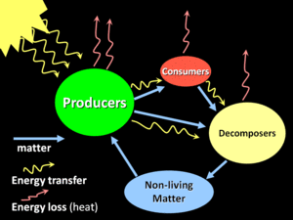
Ecology = “Oikos” (home) + ‘logy’ (science)
Ecology - study of organisms at home
Ecology - deals with interactions, relationships,
distributions & abundance
The study of the relationships of organisms to
their environment and one another (Brewer, 1988)
Ecology is the study of environmental systems, or the economy of nature
Definition- Odum (1969) Ecology is the study of inter-relationship between organisms and environment.
Biotic and abiotic interactions in an ecosystem

Slide 3
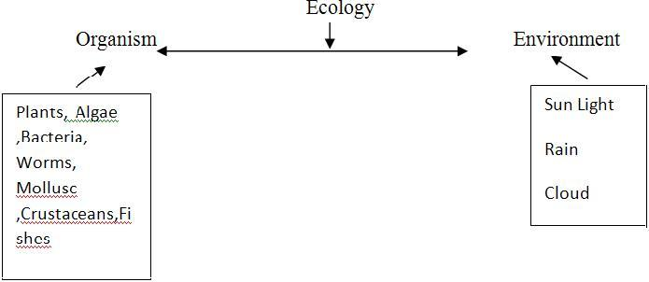
CONCEPT OF ECOLOGY
Ecology - “environmental biology” - deals with organisms in relation to their environment
The organism includes animals, plants, bacteria, fungi, virus etc. The environment includes the surroundings of plants and animals.
Example: Soil, water, air, sunlight, rock etc

Slide 4
SUB DIVISIONS OF ECOLOGY
Ecology broadly divided into subdivisions (Kirchrer and Schroter, 1902)
Autecology
Synecology
1. Autocology
Autoecology - study of individual organisms in relation to environment
Includes the study of life history, behavior, home range, population dynamics etc.
2. Synecology
Study of groups of organisms, which are associated together as a unit in relation to environment.
It deals with the study of pond ecosystem, rocky shore, sandy shore, coral reefs ecosystems etc.

Slide 5
BRANCHES OF ECOLOGY
Ecology is divided into many branches
Animal ecology – It is the study of animals in relation to their environment
Plant ecology – It is the study of plants in relation to their environment
Habitat ecology - It deals with the study of habitats
Marine ecology - It deals with marine habitat
Fresh water ecology- It deals with fresh water habitat
Physiological ecology- It is the response of single species to environmental conditions such as temperature, light etc

Slide 6
Population ecology-it is the abundance and distribution of individual species and the factors that cause such distribution
Community ecology- It is the number of species found at given area and their interactions
Ecosystem ecology- It is the structure and function of the entire organisms of microbes plants, and animals, and their abiotic environment.
Evolutionary ecology- it deals with the physiological or population level to understand how natural selection.

Slide 7
SCOPE OF ECOLOGY
Study of ecology helps
  To maintain of natural recourses
  To discover new sources of food
  To control environmental pollution
  To identify genetic materials – threatened, rare species
  To detect and measure the rate of evolution
  To determine human welfare
For survival of human race from threats- population explosion, pollution etc

