Slide 1
Ecological hierarchy, ecological organization, ecological components

Slide 2
ECOLOGICAL HIERARCHY
Biotic component Genes Cells Organs Organisms Population Community
+
Abiotic components
Biosystem Genetic Cell Organ Organism Population Ecosystem
System system system system system
Matter Energy
(Source - Flint, ML and Gouveia, P. 200)

Slide 3
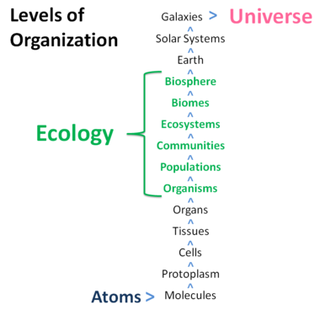
ECOLOGICAL ORGANIZATION

Slide 4
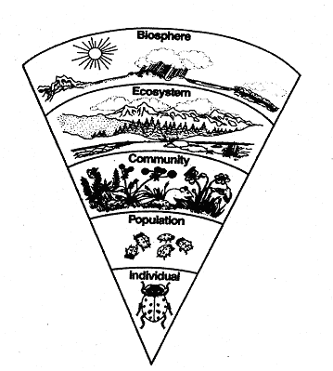
ECOLOGICAL COMPONENTS
Species
Population
Communities
Ecosystem
Biosphere
(Source - Flint, ML and Gouveia, P. 200)

Slide 5
Species
Natural group of actually or potentially interbreeding individuals reproductively isolated from other such groups. Eg. Sardinella sp. Catla sp.
Population
All the individuals of a particular species or several related species of plants and /or animals in a unit area and unit time constitutes ecological population
Nonspecific population (only one species)
Poly/mixed specific population (Several Species)
Example: - Barnacles population, Mackerel population, oysters population

Slide 6
Community
Biotic community is assemblages of several species of population that tend to occur together in various geographical areas constitute an ecological community
Example :- Rocky shore community, coral reef community, sandy shore community algal community etc.
Community - also called as ‘Bio Conenoses’ (Karl Mobius, 1977)
Phyto Coenosis – Plant Community
Zoo Coenosis – Animal Community

Slide 7
Ecosystem
Dynamic interactions between plants, animals and microorganisms and their environment working together as a functional unit
Is a community of living and non-living things that work together
Each organism has its own niche or role to play
The major parts of an ecosystem are soil, atmosphere, heat and light from the sun, water and living organisms

Slide 8
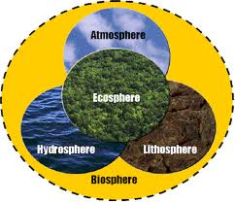
Biosphere
The biological component of earth systems, which includes the lithosphere, hydrosphere, atmosphere and other spheres
Includes all living organisms –plants, animals, bacteria, fungi etc. on earth, together with the dead organic matter produced by them

