Slide 1
ECOSYSTEM ECOLOGY

Slide 2
Ecosystem
A community or a series of communities and the surrounding physical and chemical environment together constitutes an ‘ecosystem’
An ecosystem is a dynamic entity composed of a biological community associated with abiotic environment
World Ocean is - a single ecosystem and which a large ecosystem in the world

Slide 3
Definition
A self-sustaining network of biotic and biotic elements that interact to sustain life
Ecosystem is the basic unit of study in ecology (Brewer, 1988).

Slide 4
PRINCIPLES AND CONCEPTS
The characteristic features of an ecosystem are the flow of energy, the food supply and the production of all biological resources to drive the ecosystem
Light energy from the sun is captured by green plants and converted to chemical energy- used for growth and construction
A food chain - succession of organisms in a community that constitutes a feeding sequence in which food energy is transferred from one organism to the other
At each step, some of the chemical energy is assimilated and used by the organism and the rest is released in respiration and waste products in an ecosystem

Slide 5
Homeostasis of the ecosystem
An ecosystem maintains a biological equilibrium between the different components is referred to as a homeostasis- also known as biological equilibrium
Also referred to as a balance of nature.
One component of ecosystem keeps a check on the population of the other component and this system is referred as a feedback system
Feed back system- can be positive or negative
Positive feedback- the increase in the population of the organisms at the different levels increases the population of organisms at a lower level
Eg: when population of plants increases increase in the population of herbivore animals increases the population of frogs and birds increased population of insectivorous animals acts on the herbivorous insect by the process of predation. This is known as the negative feedback.

Slide 6
TYPES OF ECOSYSTEM
Natural ecosystem (Open ecosystem)
Artificial ecosystem (Closed ecosystem)
Natural ecosystem:
Self regulating system without direct human interference and manipulations. Eg: Ponds, lakes, rivers, seas, oceans, forests, grasslands
Artificial ecosystem
Are manmade ecosystems which can be controlled and managed Eg: Aquarium, ponds, etc. Other terminologies used are
The biosphere: A major ecosystem and comprises all other ecosystem.
Mega ecosystem: Marine ecosystem -Oceans, seas, estuaries, backwaters etc.
Limnetic ecosystem: Fresh water ecosystem - Ponds, pools, lakes, rivers, streams etc.

Slide 7
STRUCURE OF AN ECOSYSTEM
Essential
component
Non essential component
Solar energy
Plant, algae, bacteria
Producers
Herbivores
Carnivores
Parasites
Consumers
Scavengers
Decomposers
Saprophyts
Nutrients
Transformers
Nonliving components Living components

Slide 8
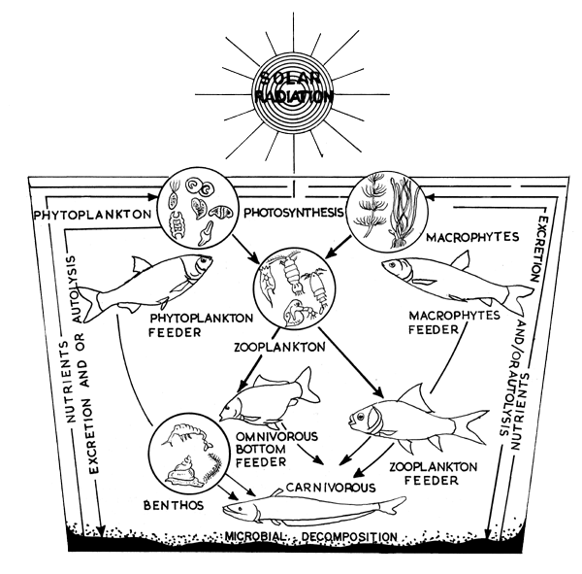
POND ECOSYSTEM- PRODUCTION AND DECOMPOSITION
Solar energy - utilized for primary production by chlorophyll-bearing plants
Conversion of solar energy into chemical energy is due to photosynthetic and chemosynthetic activities in the aquatic plant community
The rate at which organic matter produced is called primary productivity
Different forms producers and consumers are linked together through predator-prey relationship (Fig)

Slide 9
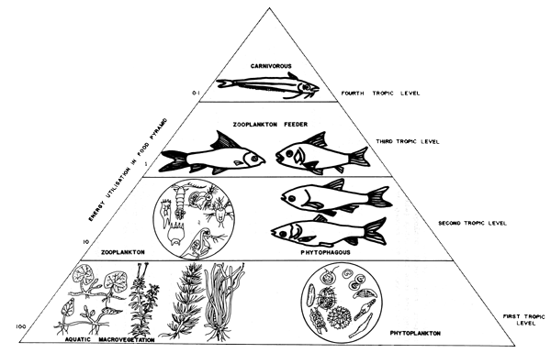
Phytoplankton, zooplankton, detritus and benthic organisms serve as food for the stocked fishes.
Pond productivity - dependent on light, carbon dioxide, temperature and essential nutrients
At low phosphate concentration, diatoms are common, but with increasing concentrations green algae become more frequent, eventually giving way to blue-green algae
Excessive phosphate - rises phytoplankton blooms which check the light penetration and thus lower the pond productivity through ‘autoshading’

Slide 10
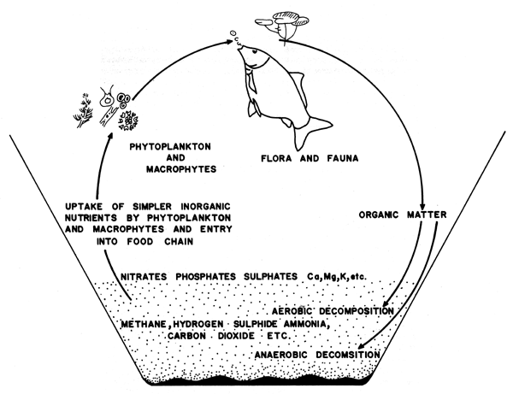
Aerobic decomposition of organic matter by bacteria in pond - important drain on the oxygen supply in ponds
Aerobic decomposition – needs continuous supply of oxygen and proceeds more rapidly when DO concentrations are near saturation
Anaerobic conditions - decomposition - rate of degradation is slow
Aerobic condition - end product of decomposition - primarily carbon dioxide
Bacterial decomposition - increase of the level of carbon dioxide and other abnoxious gases - depletion of DO - fish kills and planktonic collapses

Slide 11
Biotic components
Autotrophic organisms and heterotrophic organisms - based on how they get their nutrition, food or organic nutrients for their growth, development and survival
Autotrophs - primary producers
Green plants incorporate the sun’s energy by photosynthesis.
Heterotrophs - secondary producers or consumers - All animals

Slide 12
Autotrophs (Producers)
Autotrophs - organisms that can manufacture the organic compounds from simple inorganic compounds in the environment
Aquatic ecosystem producers - various species of floating and drifting forms of phytoplankton and bacteria
Macrophytes - producer in aquatic ecosystems
Producers – photosynthesis
The overall net chemical change can be summarized as follows:
6 CO₂ + 6 H₂O + solar energy -----> C₆H₁₂O₆ + 6 O₂

Slide 13
Heterotrophs (Consumers)
These cannot synthesize the organic nutrients they need and get their organic nutrients by feeding on the tissues of producers or other consumers
There are several classes of consumers, depending on their food source
Primary consumers (herbivores): Feed directly on plants or other producers
e.g. - zooplankton (copepods, cladocerans etc.)
Secondary consumers (primary carnivores) feed on primary consumers. e.g
Aquatic insects, crustaceans etc
Tertiary consumers (secondary carnivores) feed only on secondary consumers
e.g. small fishes
Tertiary carnivores :Feed only on animal-eating animals. They are predators
e.g. large fishes like tuna, seer fish, sharks etc.

