Slide 1
FOOD CHAIN

Slide 2
Food chain is the sequence of the eaters being eaten is called food chain
The various steps in the food chain is called “Trophic level”
Owing to repeated eating being eaten, the energy is transferred from one trophic level to another trophic level
The transfer of energy from one trophic level to another is called energy flow
There are three trophic levels of food chain in upwelling areas and five in marine environments
Normally four trophic levels of food chain in a pond ecosystem. Shorter the food chain greater the energy tranfer. Energy flows in an ecosystem through the food chain in a unidirectional and at steady state.

Slide 3
TYPES OF FOOD CHAIN
There are two basic types of food-chains in aquatic ecosystems
Grazing food chain
Detritus food chain
Grazing food chain
Starts with green plants and ends with carnivores via herbivores
Producers - own food in the presence of sunlight
The herbivorous eat the producers and the carnivores are eaten by the top carnivores

Slide 4
Predator food chain
Predator food chain one animal captures and devours another animal
The animal which kills other animals for food is called a predator
This act of hunting is called predation
Animals that are caught and eaten by a predator are called prey
Predators that only eat the meat of prey are carnivores

Slide 5
Parasitic food chain
The plants and animals of the grazing food chain are affected by parasites
Parasites derive their energy from their hosts
The parasitic chain is formed with in the grazing food chain

Slide 6
Detritus food chain
Detritus food chain starts from the dead organic matter and ends with inorganic matter
This consists of decomposers such as bacteria and fungi
Decompose the organic matter and convert to inorganic matter
Helpful for plants to prepare their food

Slide 7
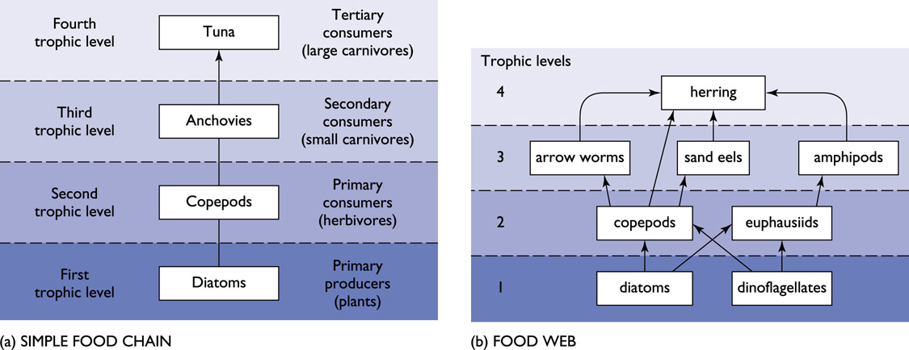
Groups of organisms feed excessively on dead bodies of animals and plants are called as “detrivores” (consists of algae, bacteria, fungi)
The groups of detrivores includes Protozoans; Insects; Polychaete worms; Crustaceans – Crab, Shrimps, Amphipods; Molluscans – Clams; Nematode worms etc.

Slide 8
FOOD WEB
Path way that transfer energy form a given plant or plants through a given series of consumer is called food chain
Food webs - important in maintaining the stability of an ecosystem
The interlocking of many food chains is called food web
Food web - non linear flow of energy
Food web - a set of interconnected food chains by which energy and materials circulate within an ecosystem

Slide 9
The food web is divided into two broad categories
The grazing web - begins with green plants, algae, or photosynthesizing plankton and
Detritus web - begins with organic debris
In a grazing web, materials typically pass from plants to plant eaters (herbivores) to flesh eaters (carnivores)
In a detritus web, materials pass from plant and animal matter to bacteria and fungi (decomposers), then to detritus feeders (deprivers) and then to their predators (carnivores).

Slide 10
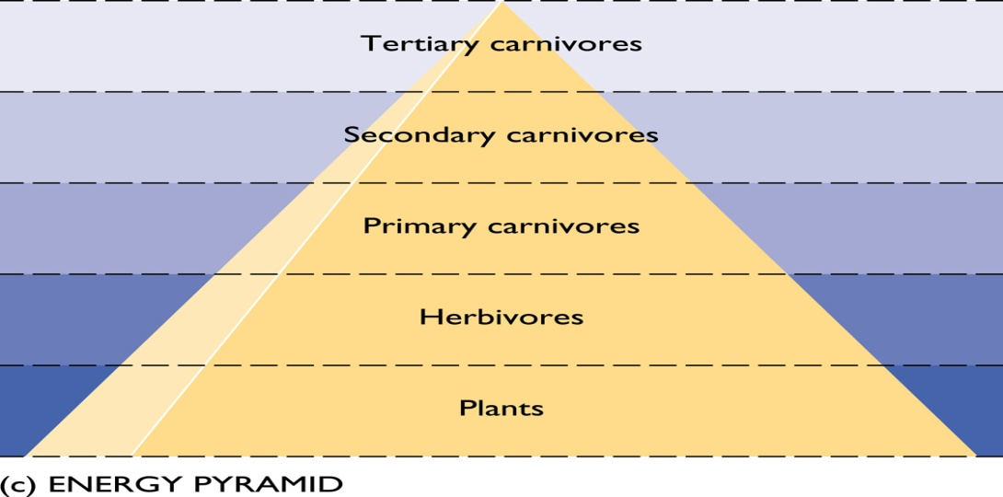
ECOLOGICAL PYRAMIDS
Ecological pyramid (trophic pyramid) - the graphical representation of the trophic structure such as number, biomass and energy of an ecosystem
First proposed by Charles Sutherland Elton (1927) and hence these ecological pyramids are called Eltonian pyramid
Begins with producers on the bottom and proceed through the various trophic levels, the highest of which is on top
There are three types of ecological pyramids viz. pyramid of numbers, pyramid of biomass and pyramid of energy.

Slide 11
TYPES OF ECOLOGICAL PYRAMIDS
Pyramid of Biomass (g /m²/ day)
Pyramid of Energy (calories)
Pyramid of Number (No /m^{2/}day)

Slide 12
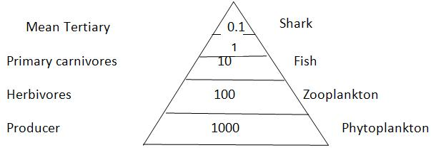
Pyramid of number
Shows the number of organisms at each trophic (relating to nutrition) level
Here the number of individuals at the trophic level decreases from the producer level to the consumer level
In an ecosystem, the number of producers is far high and the number of consumers in the subsequent trophic levels are lesser than that of the producers
Example: In a pond ecosystem, the number decreases in the following order
Phytoplankton → Zooplankton → Small fishes → Large predatory fishes

Slide 13
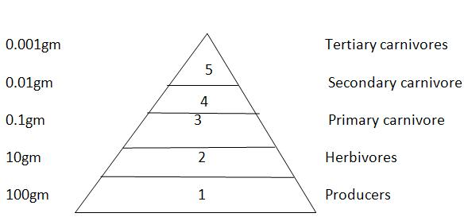
Pyramid of biomass
Biomass refers to the total weight of living organisms in a unit area
Ecological pyramid of biomass shows the relationship between biomass and trophic level by quantifying the amount of biomass present at each trophic level
The pyramid of biomass is an upright one (the apex is pointed upwards) in all terrestrial ecosystems
In certain ecosystems like pond ecosystem, the pyramid of biomass is an inverted type of pyramid (apex is pointed downwards) - contain less amount of biomass of producers and more amount of biomass of consumers (fishes)

Slide 14
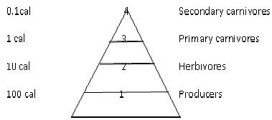
Pyramid of energy
In the food chain, energy that was originally stored by the autotrophic plants is dissipated along the food chain
More trophic links or levels in the food chain - dissipated or unusable energy loss will also be more
There is generally a 90 percent loss at each level of the food chain, creating a pyramid-shaped diagram that is wider at the bottom and narrow at the top
Example: In a pond, maximum energy is stored by the phytoplankton. Then, the energy decreases when it is transferred to the subsequent consumer levels.

