Slide 1
POPULATION ECOLOGY

Slide 2
Population ecology is the study of the variables that determine the growth, survival abundance and distribution of population in time and space
TYPES OF POPULATION
Monospecific population – One species. Eg: Catla, Rohu.
Polyspecific population – Many related species. Eg: Fish, Human, Whale

Slide 3
CHARACTERISTICS OF POPULATION
Population Density
Natality
Mortality
Age distribution
Population growth
Population fluctuation
Population equilibrium
Biotic potential
Dispersal
Dispersion
Regulation of population density
Population interactions.

Slide 4
POPULATION DENSITY
The number of individuals of a species present in a defined area is a measure of population density
There are factors such as resource availability, competition, parasitism, predation, climate, etc. that usually operate in an ecosystem to keep populations within certain boundaries
It refers to “The total number of individuals in a unit area or unit volume at a given time”
Eg: No. of bacteria/ litre; No. of plants / acre; No. of benthos / m². The density of population is expressed as, D = N/A/t. Where,D = Population density, N = Number of individuals, T = Time, A = Area

Slide 5
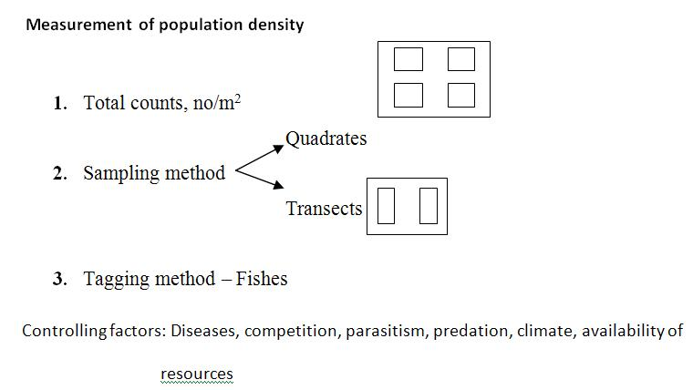

Slide 6
NATALITY OR BIRTH RATE
Birth rate refers to the average number new individuals produced by a population in a given time due to birth, hatching, germination or fission
Types of birth rate
Potential natality – Maximum rate of reproduction
Realized natality – Actual number enter new fish
Natality = Number of birth per unit time
Average population

Slide 7
Carrying capacity
It is the total number of individuals that can be supported in an area at a particular time is called carrying capacity
Factors influencing are density, pollution, habitat stress, association, disease etc.

Slide 8
MORTALITY OR DEATH RATE
Mortality refers to the number of individuals dieing in a population at a given time”
The size of population decreases due to mortality
Mortality = Number of deaths birth
Average population
Vital index
It is the ratio between birth rate and death rate is called vital index
Helps to understand the rate of growth of a population
Vital index = Birth x 100
Death

Slide 9
AGE DISTRIBUTION
A population is formed of individuals in different age groups
Birth and death rates and immigration and emigration determine age distribution (proportion of individuals in each age group) of a population
Fecundity (rate at which females produce eggs), fertility (rate at which females produce zygotes), and sex ratio (proportion of male and female in the population) affect birth rate

Slide 10
POPULATION GROWTH
The increase in size of population is called population growth
Population growth occurs when birth rates exceed death rates or immigration exceeds emigration
Population size may be regulated by physical factors (weather, water and nutrient availability) and by biological factors (food availability, predators, parasites, competitors, and diseases)
Competition for resources, parasitism, predation and diseases are example of density-dependent factors
Flood, drought, fire and other climatic conditions and most pest control actions are examples of density-independent factors

Slide 11
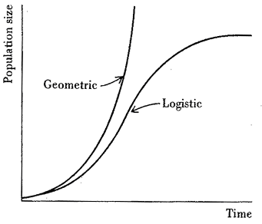
Population growth can be explained by using the equation: Nn = Nt + B - D + I - E
A population may grow exponentially or logistically (see Fig.)
The exponential or geometric population growth curve is described by the formula rN = dN/dt
where N is present population size, t is time, r is a constant called the instantaneous rate of population increase

Slide 12
The logistic growth curve dN/dt = rN (K-N)/K
where, N, t, r are the same as in the exponential growth model and K is the carrying capacity, or the maximum number of individuals the environment can support
When a population is growing in a limited space, the density gradually rises until interaction reduces the rate of increase ultimately leading to a reduction in population growth
This is logistic growth and the growth curve is sigmoid or S-shaped
The S-curve differs from the geometric curve in two ways:
it has an upper asymptote
it approaches this asymptote smoothly, not abruptly

Slide 13
POPULATION EQUILIBRIUM
After reaching the maximum number, the population remains at that level for a long period this is called population equilibrium
The population remains in equilibrium as long as the biotic and abiotic factors are optimum

Slide 14
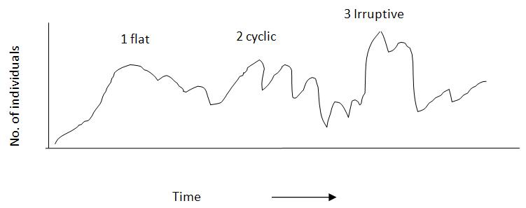
POPULATION FLUCTUATIONS
The increase and decrease in number of individuals in a population is called “population fluctuation”
BIOTIC POTENTIAL
Refers to “The inherent ability of a population to increase in number when the age ratio is stable and all environments conditions are favorable”
It is the reproductive ability a population

Slide 15
DISPERSAL
Dispersal is “a phenomenon where the individuals (not all) of a population move into or out of the population”
Allows individuals to colonize new areas
Regulates population size, evolution through mixing of genes between populations
Dispersal is accomplished through immigration (movement into a population), emigration (movement out of a population) or migration (frequent movement into or out of a population area).

Slide 16
Migration : Periodic movement of animals from one place to another and back for breeding, feeding, and shelter - Fishes, birds, mammals etc.
Catadromus – Fresh water to sea for spawning. Eg: Eel-Anguilla sp.
Anadromous – Sea to fresh water for breeding. Eg: Salmons. Trouts etc.
Emigration: It is outward migration from a population. It is one way migration and migrant never return – commit suicide
Eg: Lemming population (Small rodents)
Immigration : It is inward migration, one way migration. It changes the structure of a stable population

Slide 17
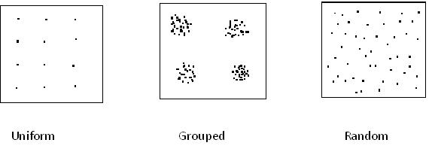
DISPERSION
It refers to the distribution of individuals with in a population

Slide 18
REGULATION OF POPULATION DENSITY
The total number of individuals of a species living in an area is called population density. Population grows by reproduction of individuals
Eg: An oyster lays about 50 million eggs
If all egg hatches, they will form a volume about eight time the size of the earth
Though the reproductive rate is high, the population does not increase as expected. This is because the density is regulated.
Density dependent factors
Density independent factors

Slide 19
Density independent factors
They are connected with population density – Extrinsic factors.
Eg: Food, space, shelter and weather
When 100 ornamental fishes are introduced into a small aquarium tank most of them die because of starvation and shortage of space.

Slide 20
Density dependent factors
They are intrinsic factors arise within the population during their growth
Competition – Competition for common resource – space food, mate etc.
Predation – Killing (predator) other animal (prey) for food
Emigration - Displacement of organisms
Reproductive – Decreases the reproductively by increasing the density
Diseases – Kills the individuals and reduces the population

Slide 21
POPULATION INTERACTIONS
Main population interactions are
Symbiosis – None of the partner affected
Competition - Both partners inhabited (Paramecium)
Predation – Predator benefited, prey is harmed (Loin and Deer)
Parasitism – Parasite benefited, host harmed (Ascaris and Mary)
Commensalism – One partner benefitted other partner is neither harmed nor benefitted (shark and sucker fish)
Mutualism – Both partners are benefitted
Eg: Hermit crab and sea anemone

Slide 22
Types of interactions
Interspecific – Between species
Intraspecific – Within the species

