Slide 1
Community ecology

Slide 2
Defintion - a natural assemblage of plants, animals and micro organisms inhabiting a given habitat
A group of population living in a unit area
Community ecology is the study of co-existing, interdependent populations
The major interactions within the community are competition, parasitism, predation, mutualism and commensalism

Slide 3
Definition
According to Clarke, a community is defined as “a group of mutually adjusted plants and animals inhabiting natural area”
Example: Pond community: Plankton, plants, fishes, insects, crustaceans, molluscas, worms, microorganisms and so on in a pond
Types of community
Major community
Minor community

Slide 4
Major community
It is a large, self sustaining, self regulating and independent unit
Eg:- coral reefs, rocky community, mangroves etc.
Minor community
It is smaller, not self sustaining and dependent on other communities for growth and survival but it is found in major community
Example - Barnacles, Oysters, Algae, Polychaetes present rocky shores.

Slide 5
COMMUNITY ANALYSIS
A procedure for investigating the structure, function and regulation of aquatic communities and understanding of ecosystem functioning
Methodologies based on biomass size, distributions, followed by food web analysis, network analysis and dynamic simulation models
Biomass size distributions provide a structural and energetic food web analysis based on measurements of abundances and body sizes, and with a few general assumptions mainly on size relationships of metabolic activities and trophodynamics

Slide 6
Food web analysis considers binary webs depicting qualitatively trophic links between species or trophic guilds and provides profound information about the food web structure
Mass-balanced flow diagrams (trophic webs) take into account the magnitude of flows between living and non-living compartments and provide comprehensive descriptions of fluxes and cycling of matter and the trophic food web structure when evaluated by network analysis

Slide 7
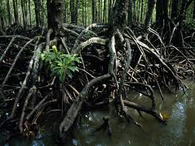
ECOLOGICAL DOMINANCE
The ecological dominance is also known as the dominant species
It refers to the most of population in a climax community
Ecological dominance is the degree to which a species is more numerous than its competitors in an ecological community or makes up more of the biomass
Most ecological communities are defined by their dominant species

Slide 8
In tropical coastal waters the dominant corals
In temperate bogs, the dominant vegetation is usually species of Sphagnum moss.
On earth, a large amount of its land ecosystems are dominated by human beings, making human beings the ecologically dominant species over much of the planet.
Tidal swamps in the tropics are usually dominated by species of mangrove (Rhizophoraceae)
Some sea floor communities are dominated by brittle stars.
Exposed rocky shorelines are dominated by sessile organisms such as barnacles and limpets.

Slide 9
Community dominance
A community has many species, of which one or few species play dominant role in the community by virtue of their number, size and activities such species are called ‘Community dominance’
The removal of community dominant from the community affects the community drastically
Species structure in most communities is either abundant or rare
Few spices that are abundant
Large number species that are rare
The abundant species are called dominants. Eg. The mussel bed in the rocky shore –Mytilus sp

Slide 10
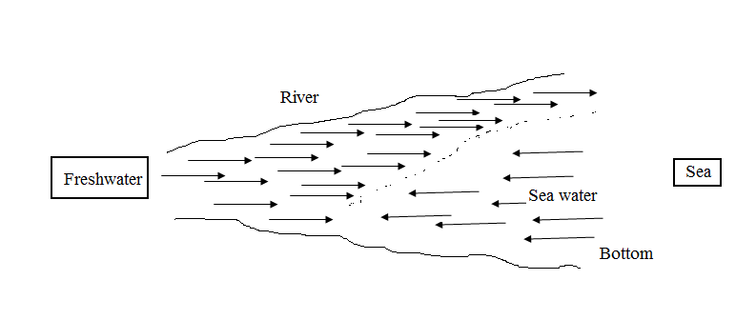
Ecotone and edge effect
Ecotone is the intermediate zone lying between two adjacent communities
Eg. An estuary is an ecotone lying between river and sea

Slide 11
Characteristics of ecotone
The ecotone prevails environmental conditions intermediate to both two adjacent communities
The ecotone offers an abundance of food and shelter
It contain organisms of both community
As a rule ecotone contains more species often denser population than either of the neighbouring communities. This is called edge effect
The ecotone contain certain species which are completely restricted to this region and they are called edge species
The ecotone may be as broad as 100 km. or as narrow as 1 .0 km.

Slide 12
Ecological niche
Niche refers to the functional status of an organism in its community
According to Odum niche is the Profession of an organism in the community
Habitat - address and niche – Profession
Niche includes what it eats, how it behaves, how it responds to the environment and interactions with other organisms in the community
Ecological niches may be
Broad niche
Narrow niche

Slide 13
Narrow niches - the role or function in the community or ecosystem has more finely subdivided and the species is specialized
Specialized species are also called specialists Eg:- muddy, sandy , rocky etc.
Broad niches - the species functions in the community is more of generalized
They are either specialists or generalists with reference to the niche - Marine or fresh water , estuarine organisms etc.

Slide 14
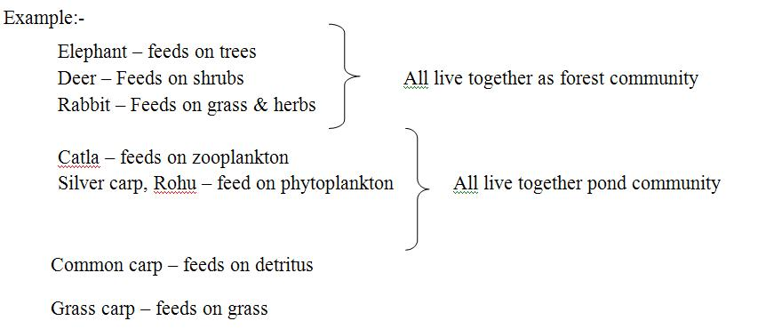

Slide 15
Ecological succession
The process of development of new communities is called ecological succession
“An orderly and progressive replacement of one community by another till the development of a stable community in that area” (Smith, 1965).
Characteristics of succession
The succession is caused due to the modification of the habitat
The kinds of programs changes continuously with succession
The diversity of species increases. biomass can also increases
The first stage of community is ‘pioneer community’ The final stage of community called ‘climax community’

Slide 16
Types of succession
Primary succession – Bacteria, Lichens – first community (pioneer) on rocks – biofilm
Secondary succession-Attached of spats of barnacles, oyster, polychaetes etc. on pioneer communities
Autotrophic succession - Dominance of algae.
Heterotrophic succession – Dominance of heterotrophs

Slide 17
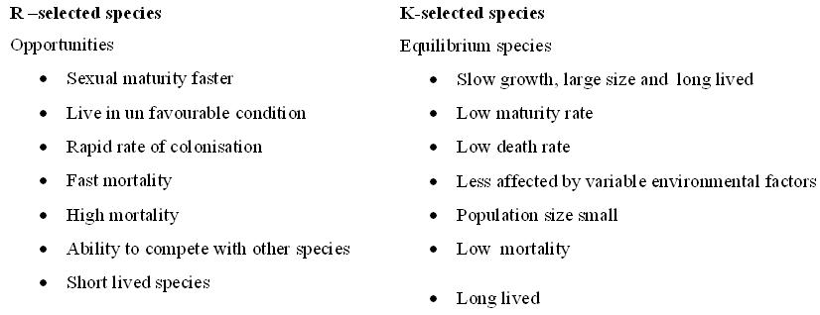
Climax community
The terminal and persistent community in an ecosystem is called climax community.
Animal are broadly grouped into
R- selected species
K-selected species

