Slide 1
COMMUNITY ANALYSIS

Slide 2
SPECIES DIVERSITY
Species diversity is a measure of the diversity within an ecological community that incorporates both species richness (the number of species in a community) and the evenness of species' abundances
Influence of species richness on species Diversity
Species diversity is influenced by species richness
Communities with more species are considered to be more diverse
For example, a community containing 10 species would be more diverse than a community with 5 species

Slide 3
Species diversity - influenced by the relative abundance of individuals in the species found in a community
Evenness measures the variation in the abundance of individuals per species within a community
Communities with less variation in the relative abundance of species are considered to be more “even” than a community with more variation in relative abundance
Community A
Species | Abundance
1 | 20
2 | 20
3 | 20
4 | 20
5 | 20
Community B
Species | Abundance
1 | 96
2 | 1
3 | 1
4 | 1
5 | 1

Slide 4
All five species in Community A have the same abundance, whereas there is great variation in abundance across the five species in Community B
For this reason, we would consider Community A to be more even
Communities with greater evenness are considered to have greater species diversity
Even though species richness of the two communities is equal (species richness = 5 in each community), Community B is less diverse than Community A because most of the individuals in Community B are members of the same species

Slide 5
Measurement of species diversity
Species diversity combines into a single figure, both the numbers of species (species richness) and the distribution of the total numbers of individuals among the species (species evenness)
Expressed through various mathematical diversity indices
High species diversity is the indicative of stable, healthy environment and low diversity is the indicative of stressful and fluctuating environment

Slide 6
Temperature, light, salinity, DO₂, CO₂, pressure and nutrients are known to limit the growth, reproduction, abundance, distribution, behavior and survival of organisms are called limiting factors
Scientists have developed a variety of mathematical equations (or indices) that incorporate both species richness and evenness into a single measure of species diversity (e.g., the Shannon-Wiener Index and Simpson’s Index)
Different diversity indices assign different weightings to species richness and evenness, so the so most useful index to choose depends on the circumstances

Slide 7
CONCEPTS OF LIMITING FACTORS
The law of minimum
The law of tolerance
The combined concept
The law of minimum (Liebig, 1840)
Any single factor exceeds the tolerance level or reduced below the minimum, the species will be eliminated - ‘law of the minimum’
Each species in a community has certain tolerances to varying environmental factors – temperature, light, nutrient, salinity, etc.

Slide 8
The law of tolerance (Shelford, 1913)
It is the survival of organisms in a good condition is possible only at a particular range of intensity zone called tolerance. Each organism has two zones
The successful survival of the organisms depends on its adjustment to these factors under this extreme environment conditions by showing tolerance and minimum availability

Slide 9
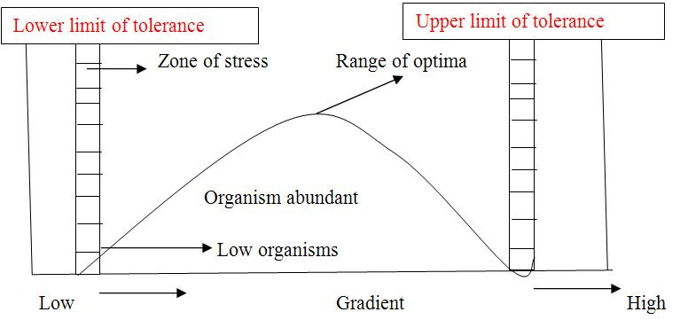

Slide 10
STABILITY & DIVERSITY
Diversity is the number of species in a community while the Stability is the relative constancy in the abundance of population
Evolution
Evolution is the survival of fittest
Survival - live long enough to reproduce and have offspring who in turn can survive
Fitness - individuals in a population are more likely to pass on their genes to the next generation

Slide 11
Natural selection
It is the differential reproduction and survival by genotypes
Natural selection is the mechanism of evolutionary change
It works on phenotypic expression of genotypes
The law of the minimum
Each species in a community has certain tolerance to varied environmental factors such as temperature, salinity and other material association
Single factor exceeds the tolerance level or reduced between the minimum and maximum, the species will be eliminated is known as the law of the minimum

