Slide 1
Biotic communities

Slide 2
The living organisms in a certain area form the biotic community
Three types of living organisms inhabit a biotic community
Producers (or autotrophs) - plants and bacteria – convert energy into food
Consumers (or heterotrophs) - eat plants and animals to survive
The consumers include herbivores (primary consumers), which eat only plants;
Carnivores (secondary consumers) - eat other animals

Slide 3
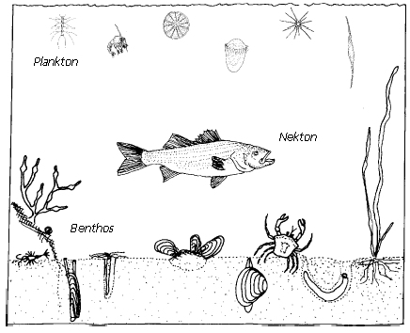
Omnivores - eat both plants and animals
Detrivores -eat plants and animals that are already dead
Examples: some fishes crabs, vultures, and termites
Decomposers - change plants that have died into nutrients that allow them to survive

Slide 4
Aquatic organisms are the referred to as biological components of an ecosystem
They can grouped according to the conditions of their existence
  Plankton
  Benthos
  Nekton
  Bacteria
  Fungi

Slide 5
BENTHIC COMMUNITIES
Those animals and plants that are attached to, crawl over, or that burrow into the bottom in aquatic ecosystems
Are always associated with benthic floor from litter zone to the deep sea system
They live in the marine sediments distributing from tidal pools along the foreshore to the abyssal depths
The term benthos comes from the Greek word meaning depths of the sea
Benthos also lives in freshwater bodies of water, such as lakes, rivers and streams.

Slide 6
The distribution occurrence and structure of most benthic organisms are determined by depth of water, temperature dissolved oxygen, salinity soil texture, availability of food and their biological interactions
Filter feeders, such as sponges and bivalves dominate the hard sandy bottoms
Deposit feeders such as polychaetes populate in softer bottoms
Fish, sea stars, snails, cephalopods, and crustaceans are important predators and scavengers

Slide 7
CLASSIFICATION OF BENTHIC ORGANISMS
Macrobenthos- (>500um)
Meobenthos - (60 and 500um)
Microbenthos - (<60um)

Slide 8


Macrobenthos
Macrobenthos are the larger, more visible, size greater than 0.5 mm in size
Examples: polychaete worms, bivalves, echinoderms, sea anaemones, corals, sponges, sea squirts, turbellarians and larger crustaceans such as prawns, crabs, lobsters, mysids, krill, isopods, cumaceans etc

Slide 9
Important macro benthoic population
Echinoderms – Star fish, sea urchin, brittle star, sealillies, sea cucumbers
Plants – Sargasssum, Ulva, Gracillaria, Hippnia, Codium
Sponges – Sycon, Grantia
Coelenterate – Sea anemones, Sertularia
Annelids – Nereis, Eunice, Sabellaria
Arthropods – Hermit crabs, Mysids, Gammarus, Isopods, Cumecians
Molluscs – Mytilus, Littorina, Patella, Murex, Teredo, Cyprea, Crossostrea, Ostrea
Prochordata - Ascidia, Botrythus
Fishes - Demersal fishes ; soles, sharks, skates

Slide 10

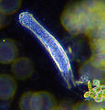

Meiobenthos
Tiny benthic organisms size less than 0.5 mm but greater than 60 µm
They are naked, present in large numbers
Important meiobenthos are Protozoans – Radiolarians, ciliates ; Coelenterates – Hydrozoa – obelia ;Annelids – Neries ; Tarligrada ; Rotifera ;Gastrotricha ; Nematode ; Archiannelide; Copepods ; Ostrocods; Mystacocarida etc.
Foraminifera Gastrotrich Copepod

Slide 11



Microbenthos
They are microscopic benthos that are less than 32 µm in size and contributing in benthic productivity
Ex:bacteria, diatoms, ciliates, flagellates etc.
Marine diatoms | Ciliates | flagellate

Slide 12
Important microbenthos are
  Ciliates
  Bacteria
  Fungi
  Larval forms

Slide 13
NEKTON COMMUNITIES
Nekton - capacity to move around in the water purposively and independently
Active swimming animals, provided with efficient locomotive organs such as lateral fins, caudal fins and stream lined body.
Eg. Fishes, cephalopods, mammals etc.
Three living classes of fish:
  The primitive jawless fishes (Agnatha);
  Shark like fishes (Cartilaginous or Chondrichthyes)
  The bony fishes (Osteichthyes).

Slide 14
PLANKTON COMMUNITIES
Plankton and neuston - consists of free floating organisms, both animals and plants whose movements are so feeble that they remain essentially at the mercy of current or other water movement
All Plankton are members of the euplankton (True plankton) as against the pseudoplankton (Nonliving debris or dead plankton)

Slide 15
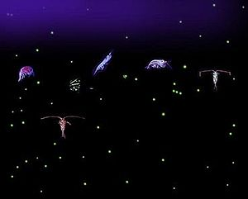
FUNCTIONAL GROUPS OF PLANKTON
There are two types of plankton - phytoplankton and zooplankton
The word phyto comes from the greek word meaning 'plant' and plankton translates to 'drifter’
These tiny organisms are plants that drift throughout the world’s oceans
Planktonic organisms

Slide 16
Phytoplankton (phyton, or plant), autotrophic, prokaryotic or eukaryotic algae that live near the water surface where there is sufficient light to support photosynthesis
Ex: diatoms, cyanobacteria, dinoflagellates and coccolithophores, silicoflagillates, green algae, blue green algae etc
Zooplankton (zoon or animal), small protozoans or metazoans(e.g. crustaceans and other animals ) that feed on other plankton and telonema
Ex: eggs and larvae of larger animals, such as fish, crustaceans, and annelids
Bacterioplankton, bacteria and archaea, which play an important role in remineralising organic material down the water column
(note that the prokaryotic phytoplankton are also bacterioplankton)

