Slide 1
PROTOZOAN ZOOPLANKTON

Slide 2
Dinoflagellates
Heterotrophic relatives to the phototrophic Dinophyceae; naked and thecate forms Noctiluca miliaris
Zooflagellates
Heterotrophic nanoflagellates protozoans are foraminiferans, radiolarians and tintinnids

Slide 3
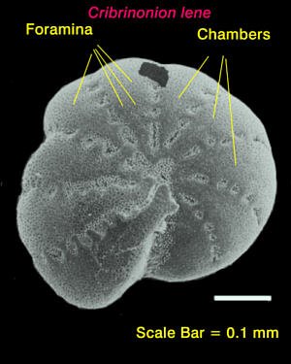
Foraminiferids and Radiolarians
Single celled protozoans with shells
Are protozoans, exclusively marine, few species present in plankton in all oceans
Commonest genus among plankton foraminifera –Globigerina
Species like Orbulina, Globorotalia - found in Indian ocean
Globorotalia sp

Slide 4
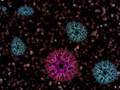
In contrast to foraminifera, radiolarians are benthic; exclusively pelagic found in all oceans
Radiolarians - spherical, amoeboid cells with silica capsule; 50 µm to several mm;
Shells - siliceous except Acantharia sp. - posses skeleton of strontium
Important genera Acanthometron sp.Thalassiocolla sp. etc.
Acanthometron sp

Slide 5
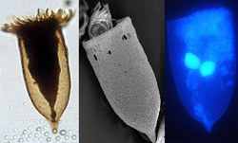
Ciliates
Mostly marine organisms commonly called as tintinids
Tintinids have cosmopoliton distribution and restricted to surface waters and sediments
Important genera found in Indian Ocean are Tintinopsis, Favella, Codonellopsis, Rhabdonella, Eutintinnus etc.
They form important food for copepods, euphassids, cladocerans, salpids, chaetognaths, fish larvae etc.

Slide 6
Coelenterates
Gelatinous zooplankton commonly called as jelly fishes, predominated in the zooplankton, solitary
Measures few mm. to several meters
Often cause nuisance to fishermen using nets and swimmers
Medusae of coelenterates are conspicuous elements of macroplankton having bell shaped or saucer shaped body are meroplanktonic

Slide 7
Important hydrozoans such as Obelia, Bougainvillia, Leukartiara sp. Bougainillia sp, Aequorea sp,. Cosmetira sp., Phillidium sp., Obelia sp, Liriope sp, Aegina sp etc.
Important siphonophores are Diphyes sp., Lensia sp., Muggieae, Physalia, Porpita, Velella, etc. The scyphozoans include larger jelly fishes such as Aurelia, Cyanea, Pelagia and Rhizostoma present in the pelagic zone

Slide 8
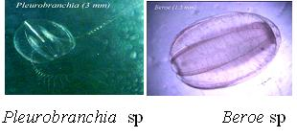
Ctenophores
Are holoplanktonic, largely present in the plankton samples
Ex: Species of Pleurobranchia sp and Beroe sp common ctenophores present in the Indian seas

Slide 9
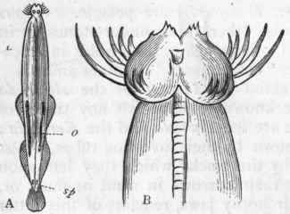
Chaetognaths
Commonly known as arrow worm or glass worms
They are exclusively holoplanktonic, present in all oceans, live at all depths,
Serve as reliable indicator species as they occur characteristically in warm waters
Voracious predators, some feed on freshly hatched fish larvae nearly as large as themselves
Sagitta enflata

Slide 10
Nine genera and about 42 species are recognized
Most species belong to the genus Sagitta, Eukrohnia, Pterosagitta, Spadella etc.
The important forms present in Indian Ocean are Sagitta bombayensis, S. setosa, S. enflata, S. robusta.
S. padella sp is the only benthic species present in marine waters.

Slide 11
Planktonic polychaetes
Planktonic polychaetes are annelids , resembles Neries sp, true holoplanktonic and have wide distribution
Families such as tomopteridae, typooloscolcidae, atciopidae are present in marine waters
Tomopterus sp are the most conspicuous forms of polychaetes present in plankton samples
Tomopterus sp

Slide 12
Planktonic molluscs
Represented by pteropods which have wing like extensions of the foot
The holoplanktonic pteropods include two groups
Gymnosomata (Clione sp) without shell
Thecosomata (Cavolinia) with shell
The genera creseis and cavolina - in marine waters
Gastropod molluscs (pelagic) - Creseis acicula, Cavolinia tridentate, Janthina roseola etc.

Slide 13
Urochordates
Urochordates are notochordates, gelatinous, holoplanktonic tunicates.
Among the protochordiates appendicularians and thaliaceans are important groups
Appendicularians are represented by Oikopleura dioica, Fritillaria venusta

Slide 14
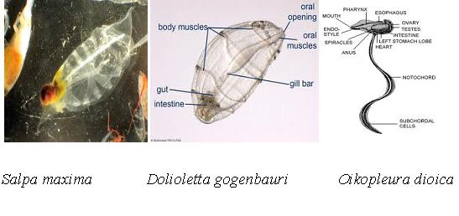
Thaliaceans by Pyrosoma, Dolioletta gogenbauri, Salpa cylindrica; Salpa fusiformis; Salpa maxima; Salpa thomsoni; Salpa tilsicostata; Thalia democratica etc.
They are mostly warm water forms, common in equatorial, temperate and cold seas at the surface
They feed on plankton and forms food for fishes

