Slide 1
Crustacean copepods

Slide 2
Crustaceans are non gelatinous important forms of the zooplankton
The crustaceans are divided into subclasses
1.Brachiopoda
2.Cirripedia
3. Ostracoda
4. Copepod
5. Cladocera
6. Cumaceae
7. Mysidaceae
8. Euphausidae
9. Amphipoda
10. Isopoda etc.

Slide 3
Copepods - dominant constituents of zooplankton present in all seas
Serve as the chief food of the commercially important shoaling fishes
Diatoms - principle food for most planktonic copepods
Copepods are divided into seven suborders
Among them, calanoida(Microcalanus sp, Eucalanus sp. Temora sp. Lebidocera sp. Pontella sp. Acartia sp. etc); cyclopoida(Copilia sp, Oncaea sp, Sapphirina sp, Corycaeus sp. etc. and herpecticoids (Macrosetella sp, Clytemnestra sp. Aegisthus sp. etc. are important

Slide 4
Copepods are dominant constituents of zooplankton present in all seas
Copepods serve as the chief food of the commercially important shoaling fishes
Diatoms constitute the principle food for most planktonic copepods
More than 4500 species of copepods have been described, of which about 90% are marine

Slide 5
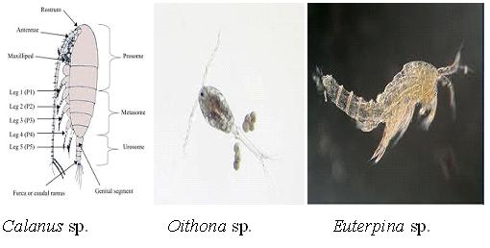
Copepods are divided into seven suborders. Among them, calanoida(Microcalanus sp, Eucalanus sp. Temora sp. Lebidocera sp. Pontella sp. Acartia sp. etc); cyclopoida(Copilia sp, Oncaea sp, Sapphirina sp, Corycaeus sp. etc. and herpecticoids (Macrosetella sp, Clytemnestra sp. Aegisthus sp. etc.are importent.

Slide 6
Cladocera (water fleas)
Important marine zooplankton, abundant in plankton samples
Feed on phytoplankton and detritus matter
Cladocerans such as Penilia, Evadne and Podon are found distributed in inshore waters
They are extremely seasonal, reach high density for short period in temperate waters
They reproduce parthenogenetically

Slide 7
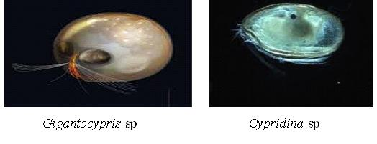
Ostracods
Are smaller crustaceans abundant in tropical coastal waters
Characterized by having carapace shell as bivalve shell
Species like Gigantocypris. Conchoccia, Halocypris Cypridina, Sarsiella etc. have wide distribution in marine waters

Slide 8
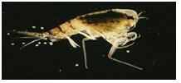
Amphipods
Amphipods are less abundant in pelagial, frequently found on siphonophores, medusae, ctenophores, slaps etc.
Common genus is Cythere, Bairdia, Themisto etc.

Slide 9
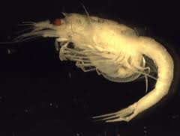
Mysids
Mysids or opossum shrimp appear like decapods, shrimps, resembles Euphausids
Are mostly marine
Are omnivores - feed on living and dead plants and animals
Hyperiids, Gammarids and Caprellids - three major groups present in plankton
Neomysis, Boreomysis, Eucopia, Gnathophausia, Mesopodopsis etc. present in Indian waters

Slide 10
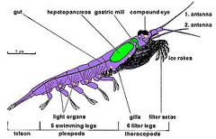
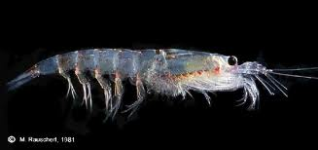
Euphaussids: krill
Euphausids (Euphasia superb) form a major component of the zooplankton and form important in marine food chain
Small shrimp like large species
Form important food for varieties of fishes- herring, mackerel, copelin, salmon, sardines, herring, salmon, tuna etc. and also for seals, oceanic birds, tuna, whales etc.
Euphasia superb

Slide 11
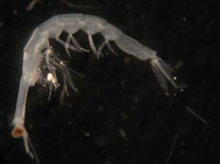
Decapods
Include most of the larger conspicuous crustaceans such as prawn, lobsters, hermit crabs and crabs and are generally benthic in the adult state
Most of them have pelagic larvae and some of these which are pelagic as adults
Are strong enough swimming to be classed as nekton rather than plankton, Lucifer is the genus highly modified for planktonic existence
Lucifer is an important genus present abundantly in the Indian seas.
Lucifer hanseni

Slide 12
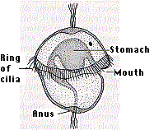
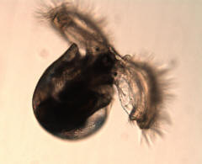
Ichthioplankton
Mollusca:
Clams and snails produce ciliated trocophore larvae and shelled veliger larvae
Ciliated velum serves for locomotion and food collection
Trochophora larvae Veliger larvae

Slide 13
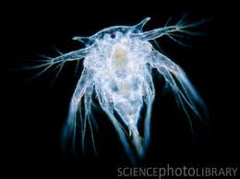
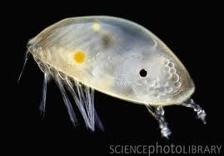
Cirripedia: Barnacles produce nauplii, which turn to cypris
Nauplii, Cypris

Slide 14
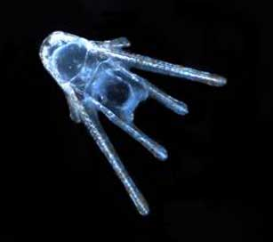
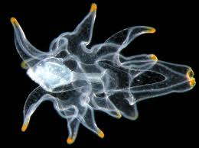
Echinodermata: sea urchins, starfish and sea cucumber produce pluteus larvae of different shapes, which turn into brachiolaria larvae (starfish); metamorphosis to adult.
Pluteus larvae Brachiolaria larvae

Slide 15
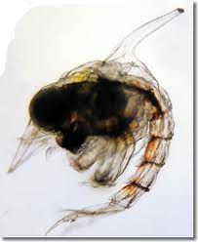
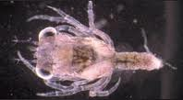
Decapoda: shrimps and crabs produce zoëa larvae; they turn into megalopa larvae in crabs
Zoëa larvae Megalopa larvae

Slide 16
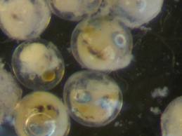
Pisces: fish eggs and larvae referred to as ichthyoplankton; fish larvae retain part of the egg yolk in a sack below their body until mouth and stomach are fully developed
Fish eggs Fish larvae

Slide 17
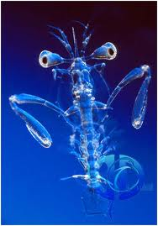
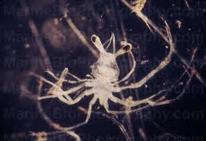
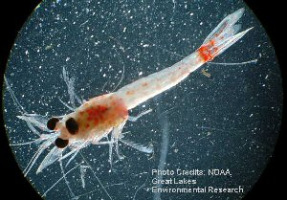
Squilla larvae Phyllosoma larvae Mysis larvae

