Slide 1
ANIMAL ASSOCIATIONS AND INERACTIONS

Slide 2
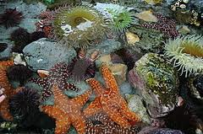
Ecology is the study of the interrelations of organisms and environment
Interrelationships or animal associations either direct or indirect, exist among members within a species (Intra specific) or between members of different groups (Inter specific)

Slide 3
Symbiosis
Commensalisms
Parasitism
Natural selection
Artificial selection
Prey – predator relationship
Host - parasitic relationship

Slide 4
Association between organisms is for similar requirements in the environment
Number of unrelated organisms is occurring together in associations
Animal adapted to live in conditions of competition for space and food, owing to their better means of protection / survival / proliferation and association is predominant in such communities.

Slide 5
Natural association of organisms
Animal associations are grouped into four principal types based on their degree of intimacy and casual influences.
Community
Commensalism
Parasitism
Symbiosis

Slide 6
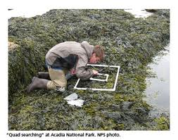
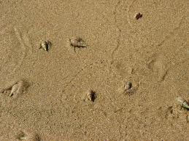
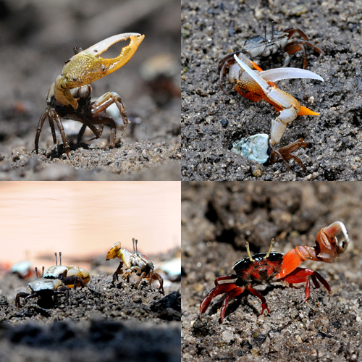
Communities and their habitat

Slide 7
Benthic associations
The animals and plants bring about fundamental changes in the marine environment due to their activities.
Burrowing organisms worms, molluscs, crustaceans
Boring organism- bivalve, crustaceans
Accumulating organism biological oozes
Depositing organisms worms, polychaetes

Slide 8
Benthic communities
Macoma community
Tellina – Donax community
Venus community
Syndosmya community
Dendraster community
Amphiura community

Slide 9
The interaction is essential obtaining food and shelter and for meeting other necessary requirements
The interaction or inter-dependence or inter-relationship between the individuals of the same species is known as intra-specific relationship
Relationship between the organisms of different species is termed as inter-specific relationship
Two types of inter-specific relations - symbiosis and antagonism
Symbiosis - either one or both the species are benefited but neither species is harmed
Antagonism - any one of the partner species is harmed

Slide 10
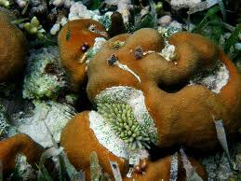
SYMBIOSIS
Symbiosis - partnership between two dissimilar organisms for mutual benefit
Symbiosis - close association of two distinct organisms for mutual benefit, so that each partner loses at least some degree of physiological independence
Association of this type where in which the relationship is intimate is called “physiological symbiosis”
Loose associations between animals referred to as “cleaning symbiosis”

Slide 11
Cleaning symbiosis
Mutually beneficial relationship in which certain animals remove ectoparasits, bacteria, diseased and injured tissues and unwanted food particles from other co-operating animals
Wide occurrence in the marine environment and many fishes, turtles, sea urchins are known to be cleaned by specific symbionts like fishes, shrimps and crab
Examples- Oxyjulis - a California fish is known to remove parasitic copepods and isopods from fishes
The neon goby (Elacatinus occanops) striped yellow fish found in corals, attaches to the host fish and nibbles the parasites from it. (Epinephelus sp. Serranus sp. Pomacerentrus sp.)

Slide 12
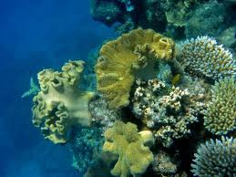
Physiological symbiosis
True symbiosis
Association between the two organisms is so intimate that one of the partners may be incapable of living alone
Eg. An association between algae (Zooxanthellae ) and marine invertebrate corals
The unicellular algae are found within the tissue cells but in outer border line, the algal cells are found either in the body cavity or in the intracellular space
Among the marine invertebrates algal symbionts are most common in protozoan’s, sponges, coelenterates, turbillarians and molluscs.

Slide 13
Symbiotic relationship between algae and corals
The association is beneficial to both organisms
Here algae benefit by deriving protection and securing carbon dioxide and nitrogen’s waste products from the coral-host
The host obtains additional oxygen supply and secured the elimination of waste substances

Slide 14
Symbiosis with algae is well known in Mollusca – Tridacna sp and Hippolpus sp.
Tridacna is a giant mollusc inhabits in coral reefs, it grows one and half meters and it contains millions of tiny zooxanthelle on outer tissues
The symbionts remove waste products i.e., CO_{2,} nitrogen, phosphorus and other nutrients
Besides clam get nourishment by digesting their algae for nourishment

Slide 15
Significances of physiological symbiosis are
Both associates are benefitted
Removal of waste from the host
Utilisation of nutrients & wastes by algae
Additional supply of oxygen by algae
Many animals obtain nutrition in corals.
Symbiotic relationships - two categories - mutualism and commensalism
In mutualism both the partners are mutually benefited while in commensalism only one of the partners is benefited

Slide 16
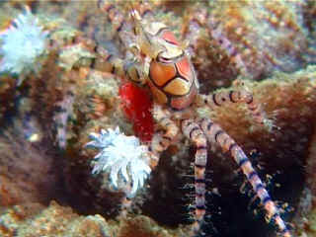
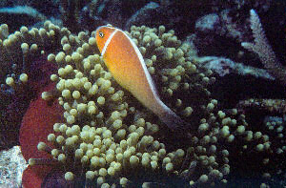
MUTUALISM
A relationship between two dissimilar organisms that are mutually beneficial is called mutualism
The term mutualism literally meaning ‘living together’ was first coined by De Bary
The association may be obligatory or continuous, facultative or transitory
In continuous or obligatory mutualism, the individuals or symbionts cannot live apart
In facultative mutualism the individuals can successfully live apart from each other

Slide 17
Obligate Mutualism
A permanent type of relationship in which two symbionts are in close contact and interdependent on each other
Also referred as mutualism with continuous contact
Examples:
Hermit crab and sea Anemone-
Hermit crab (Eupagurus sp) lives in the empty shell of a snail
The outer surface of the shell is inhabited by the sea anemone (Adamsia sp)
The hermit crab is protected from the enemies by the nematocysts of the sea anemones
The sea anemone derives food from hermit crabs and gets transported from one place to another

Slide 18
2. Giant clam and zooxanthellae-
Giant clam, Tridacna gigas lives in the well lighted shallow coastal water
Its mantle cavity harbours huge population of the algal symbiotic dinoflagellate species, which is commonly called Zooxanthellae (Symbiodinium microadriaticum)
Since the clam shells are very thick, the shells cannot be closed and this helps the symbiotic algae to receive good sun light and carry out photosynthesis
Some of the older cells of these algae are in turn consumed by this giant clam

Slide 19
II. Facultative mutualism
partners or symbionts are rarely attached to each other and if so it is only for a short duration
It is also called as mutualism without continuous contact
Though both the partners are benefited from each other but the nutritional need is primary at least for one of the species
Ex: crocodile (Crocodylus spp.) and crocodile-bird (Pluvianus aegyptius), which removes leaches from around the teeth of the crocodile which allows the bird to enter its mouth for the search

Slide 20
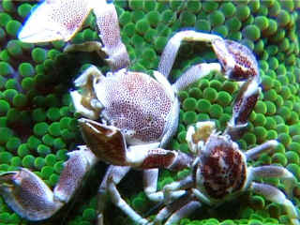
COMMENSALISM
Interaction between two different species of living organisms, where one partner or species benefits and the other species is neither benefited nor harmed
Derived from the Latin word commensa, meaning sharing a table as guest messmates - coined by Van Beneden
There is no physiological interdependence among the partners and the partners are referred as commensals
Purpose - to get food, space, shelter, defense and transport

Slide 21
Based on the position or location of the commensal on the host species - grouped into Endocommensals and Ectocommensals
Commensalism is of the following two types based on the level of association between the commensals.
Permanent commensalism
Temporary commensalism

Slide 22
b. Temporary Commensalism
The commensals remain only in temporary contact with each other
This intermittent contact between the animals for food, shelter or for breeding sites is seen in many marine animals. Examples - Sucker fish and shark
Temporary association or contact between two animal commensals is seen in sucker-fish and the sharks or whales
Sucker-fish (Echeneis) is found attached by means of its dorsal sucker to the underside of a shark or other large animal

Slide 23
The decapod crustacean, Polyonyx lives in the U-tube of the marine annelid, Chaetopterus
It obtains food particles and oxygen supply from water entering the tube due to the pumping action of the worm’s parapodia.
2. Portuguese man-of-war and fish
Based on the position or location of the commensal on the host species, it is grouped into Endocommensals and Ectocommensals.

Slide 24
TYPES OF COMMENSAL RELATIONSHIPS
Epizoism
Endoecism
Inquilinism
Epizoism :
Many sedentary marine animals are “epizooic” organisms setting facultative or even obligatory on others, particularly in those with hard shells
Eg : Ciliates, hydroids, bryozoans, sedentary polychaetes and cirripides settle on lamellibranches, gastropods, crustaceans

Slide 25
Endemism
A partnership in which animal habitually takes shelter within the tube or burrow of another
Here, shelter or protection is the factor behind the association. However, in some cases food sharing relationship
Examples-
Burrowing and tubicolous annelids, echiuroids, echinoderms, crustaceans etc., are host for many commensals. The burrow of an echinoid warm (Urechis alepo) is shared with an arrow goby (Clevelandia ios), a scale worm (Hespernoe adventor) a clam (Cryptomya sp.) and a pea crab (Scleroplax sp.)
Commensal (Nereis fucate) live in the whelk shells inhabited by hermit crab (Eupayurus sp.) for protection as well as food.

Slide 26
Inquilinism :
This commensal association in which one lives within the other, the former utilizing the host animal mainly as refuge
Here protection is the factor behind association
Examples
Hydroid Colony lives by attaching to the Lamellae of the ctenidia of wood boring molluscs such as Teredo furcifera, Martesia striata.
The pearl fish (Carapus acus) dwells in the intestine of a sea cucumber

