Slide 1
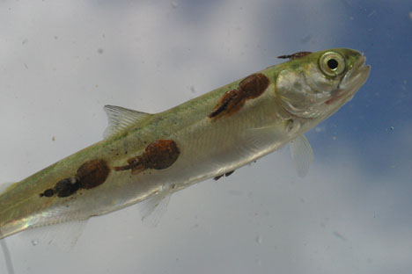
PARASITISM

Slide 2
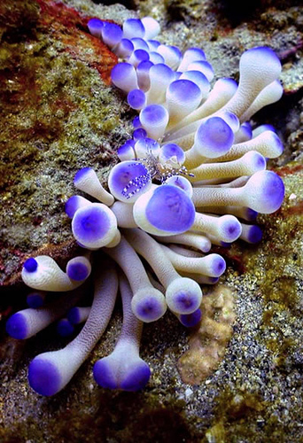
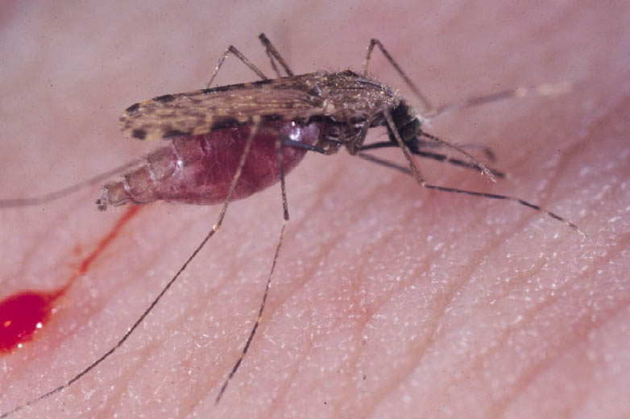
In this relationship, one animal or species (the parasite) benefits at the expense of the other (the host)
The benefited partner is called as parasite and the affected partner is a host

Slide 3
I. Parasite
A parasite is an organism which exploits another organism for the purpose of nourishing from its tissues
It lives in or on the body of the host
A number of organisms also go through a parasitic stage at some point during their lives and afterwards they lead a different life
Hence, based on the duration of parasitic mode of life, parasites are classified as permanent and temporary parasites

Slide 4
a. Temporary parasites
Those organisms which spend only a portion of their life as parasites on the host are called temporary parasites
E.g. Lamprey (Petromyzon) and marine fish. The lamprey sucks the blood from the large fishes with its sucker and leaves the host
This type of parasitic forms is also known as facultative parasites
The glochidium larva of freshwater mussel attaches to the host fish by its hooks till it attains a young stage and leads a permanent benthic life

Slide 5
b. Permanent parasites
Those organisms which spend their entire life as parasites are called permanent parasites
The permanent parasites of plants are called the phytoparasites and those of animals as zooparasites
These are also called as obligatory parasites, which must need a host
The permanent parasites can be divided into two categories, viz. ectoparasites and endoparasites
The former referring to external parasites, and the latter internal parasites

Slide 6
The endoparasites are further divided into intracellular parasites and intercellular parasites
Parasites which live inside the host cell are called intracellular parasites (e.g. Trypanosoma)
Those which live in between the cells of the host are intercellular parasites (e.g. flukes, isopods, etc.)
Another marine example is that the male angler fish of very small size is attached to the large sized female fish, Antennarius hispidus
This attachment of male fish with female is to get nourishment as well as for reproduction. This type of parasitism is also termed as sexual parasitism.

Slide 7
2. Hyperparasitism
Sometimes, parasites themselves are parasitised by other organisms - hyperparasites
Example, Nosema notabilis is a hyperparasite on myxosporidian, Sphaerospora polymorpha - a common parasite of the urinary bladder of the toadfish

Slide 8
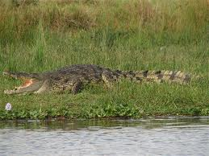
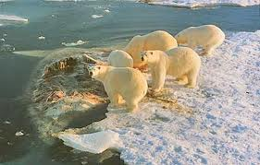
PREDATION
An animal relationship where one animal kills and devours the other animal for food
A predator - which kills its prey belonging to another species for food and the animal which is killed, is called prey
As Elton observes “the predator is said to live on capital whereas the parasite lives on interest”
Predator is bigger than the prey while parasites are smaller than their host

Slide 9
All animals and insectivorous plants are predatory
The predators are of two types - herbivorous and carnivorous
The predators which eat plants are called herbivores
The predators which kill and eat animals are called carnivores

Slide 10
COMPETITION
A common feature found in animals and it adversely affects the other species with reference to food, space, light, oxygen or any other common need
Two types - intra-specific competition and inter-specific competition
Intra-specific competition - competition between the individuals of the same species, e.g. some of the larger fishes preying on smaller fishes
Inter-specific competition - competition between two different species. E.g. Fishes eating the mosquito larvae and Carnivores feeding on the herbivores

Slide 11
S. No | Type of Relationship | Species A | Species B | Effect of relationship
1. | Neutralism | 0 | 0 | Neither species affects the other.
2. | Mutualism | + | + | Favourable to both.
3. | Commensalism | + | 0 | Favourable to A, the commensal, but not to B, the host.
4. | Exploitation or Parasitism | + | - | Favourable to A, the parasite but harmful to B, the host.
5. | Predation | + | - | Beneficial to A, the predator but harmful to B, the prey
6. | Competition | - | - | Harmful to one species or the other.
‘+’ - denotes the fact that both members of the partnership are benefited
‘-’ refers to the harmful nature of the association
‘0’ denotes the fact that there is no significant effect as a result of partnership on the partners

Slide 12
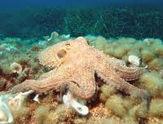
PREY – PREDATOR INTERACTION
“Predators” are hunting animals that capture and kill their “prey”
Factors influencing the state of predation - the abundance of the prey
If the prey is dense, a predator will be able to capture as many as it needs with a minimum of effort and time
If the prey is sparse, the predator will have to seek persistently even to catch only a few.

Slide 13
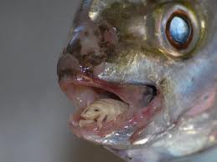
HOST AND PARASITE RELATIONSHIP
The concept of parasitism is complete in relationship between the parasite and its host
Parasitism - is the condition of life normal and necessary for an organism that lives on or in its host and that nourishes itself at the expenses of the host without destroying it as a predator does its prey but after influence some degree of injury affecting its welfare

Slide 14
NATURAL SELECTION
Nonrandom process by which biological traits become more or less common in a population as a function of differential reproduction of their bearers
Charles Darwin coined the term "natural selection,"
Natural selection is one of the basic mechanisms of evolution, along with mutation, migration, and genetic drift
Natural selection is a very efficient, predictable mechanism of evolution, illustrating mainly on
how species adapt to their environment
the reproductive success of a species
design in nature
evidence of evolution in action, e.g., antibiotic resistance etc.

Slide 15
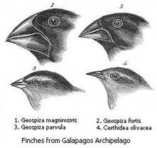
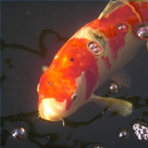
What is natural selection
Natural selection is how species evolve by adapting to their environment and it is the driving force behind the evolutionary process
Fishing drives natural selection for smaller fish that grow more slowly and have reduced reproductive potential
Large fish with huge reproductive potential are being replaced by smaller fish with diminished reproductive potential

Slide 16
Natural selection is the process by which species adapt to their environment
The organisms with the best or most favorable genetic adaptations out-compete other organisms in a population, tending to displace the less-adapted organisms
Natural selection leads to evolutionary change and pass on these inheritable genetic characteristics to their offspring
Natural selection is a consistent difference in survival and reproduction between different genotypes - reproductive success

Slide 17
A genotype is a group of organisms sharing a specific genetic makeup
Darwin used concept of natural selection to explain the variation he observed within and between species
The adaptations which conferred survival advantages in a given environment would come to dominate a population, or else being equal

Slide 18
ARTIFICIAL SELECTION
When the population is fished, many of the largest fish are removed, so, more of the small-bodied fish remain
Artificial selection is the intentional selection, breeding of plants or animals. It means the selective breeding

Slide 19
The breeder has to select animals to breed that have such a good quality
Selective breeding often leads to inbreeding and loss of fetility
To control this, most breeds are outcrossed or backcrossed to wild-type individuals or at least less inbred stock

Slide 20
Charles darwin used the example of artificial selection to introduce his idea of natural selection
Artificial selection may be contrasted with the process of natural selection
In natural selection, the differential reproduction of organisms with certain traits happens
This is because some variations help the organism to have better survival and reproduction and also maintains or enhances the fitness of a population in its natural habitat

Slide 21
Inbreeding is a particular kind of selective breeding, designed to produce a population which is genetically, virtually identical
Sometimes a dwindling population needs a jumpstart. And for threatened or endangered fish populations, that often means supplementing wild populations with hatchery-raised fish
But this conservation tactic is not risk-free: hatchery fish populations may evolve in different directions from wild populations—and hatchery genes may be dangerous for wild populations

